Slide 1
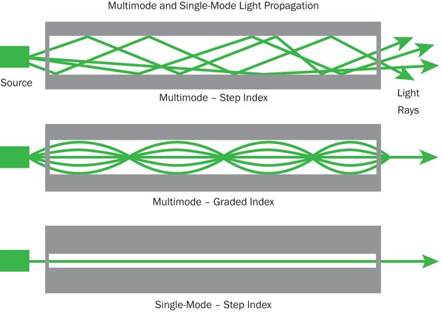
Fiberoptics
Function as a light guide
Fiber categories based on propagation:
Single Mode Fiber (SMF)
Multimode Fiber (MMF)
Categories based on refractive index profile
Step Index Fiber (SIF)
Graded Index Fiber (GIF)

Slide 2
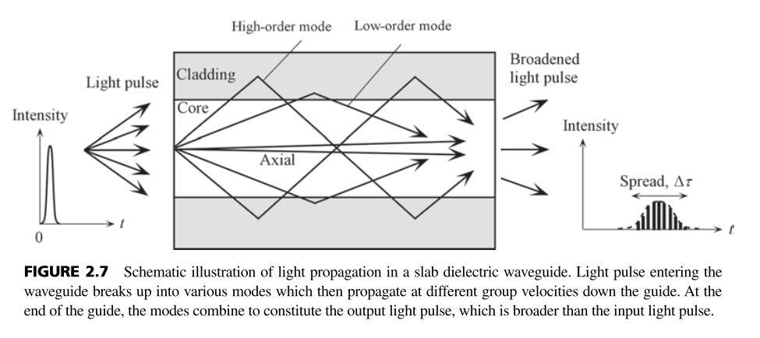
Fiberoptics
Dispersion
Input signal spreads out as it propagates along the fiber.
Chromatic dispersion
Occurs by the different speeds of light rays.
Material dispersion:
Different speeds due to the dispersive property of the material.
Waveguide dispersion:
Different speeds in the core and the cladding.
Polarization mode dispersion
Different speeds for different polarization axis.
Modal dispersion
Significant in multi-mode fibers

Slide 3
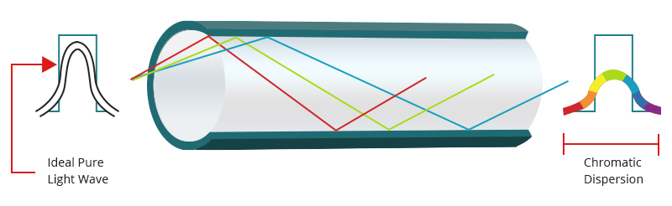
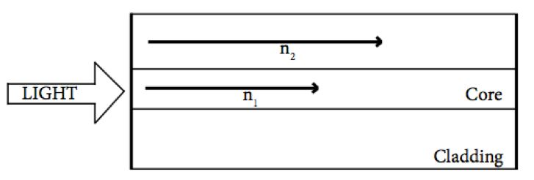
Fiberoptics: Chromatic dispersion
Material dispersion
Waveguide dispersion
Particularly significant in single mode optical fiber.
Images from: https://community.fs.com/blog/types-of-optical-fiber-dispersion-and-compensation-strategies.html

Slide 4
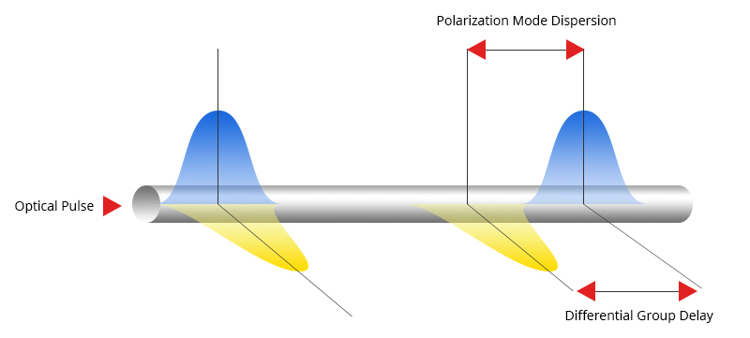
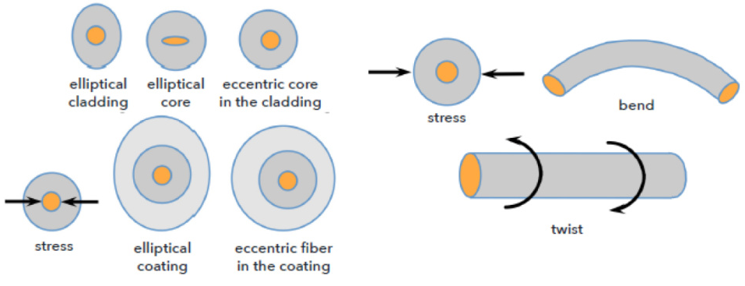
Fiberoptics: Polarization mode dispersion
Polarization mode Dispersion
For normal fiber, the speed of each polarization is different, because of non-concentricity or ovality.
PMD is affected by fiber manufacturing, cabling, installation, and operating conditions.
Images from: https://community.fs.com/blog/types-of-optical-fiber-dispersion-and-compensation-strategies.html

Slide 5
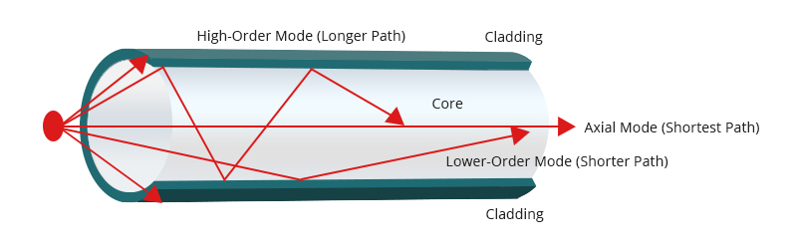
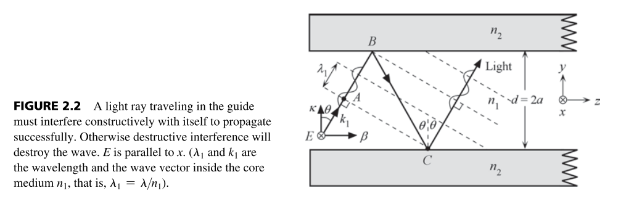

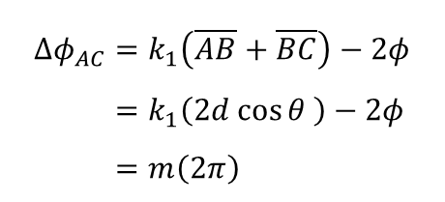
Fiberoptics: Modal dispersion
Especially important for multi-mode optical fiber.
TE mode propagation in a planar waveguide.
In geometrical optics, the mode in the optical fiber is constructed when the phase difference between points A and C.
$$Δφ_{AC}=k_{1}\left(\overline{AB}+\overline{BC}\right)−2φ \\ =k_{1}\left(2d\cos{θ} \right)−2φ \\ =m\left(2π\right)$$
Only certain $θ$ and $φ$ can satisfy this condition for a given integer $m$.

Slide 6
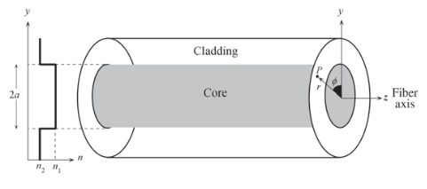
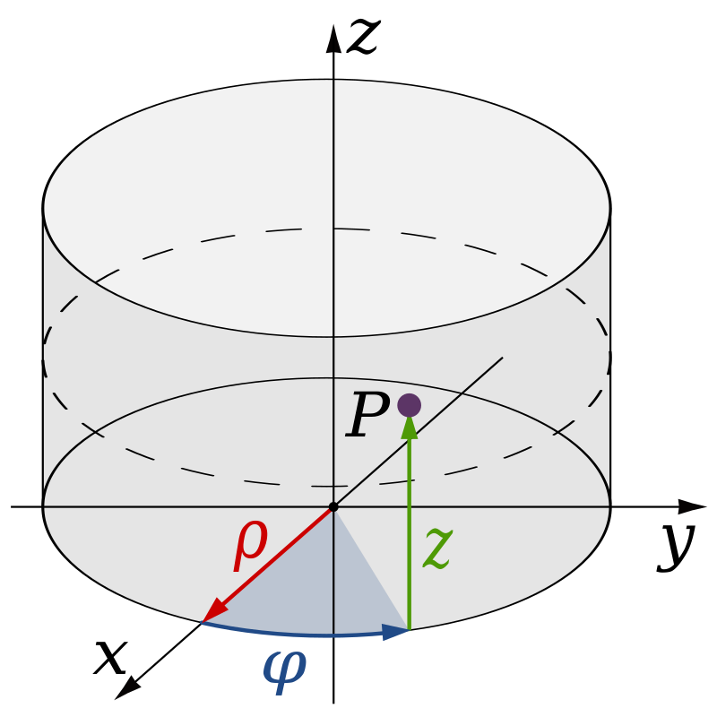
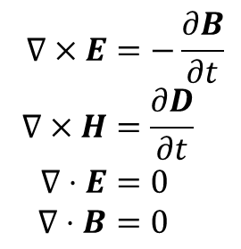
Fiberoptics: EM waves in optical fiber
To accurately determine the distance to the target when the light passes through the optical fiber,
the electromagnetic fields inside of the optical fiber should be accurately described.
For this sake, we will solve Maxwell’s equations in optical fiber using cylindrical coordinates.
The step-index fiber
The schematic of the step-index optical fiber.
Cylindrical Coordinate
Maxwell’s equations in free space
$$∇×E=−\frac{∂B}{∂t} \\ ∇×H=\frac{∂D}{∂t} \\ ∇⋅E=0 \\ ∇⋅B=0$$
EM wave in an optical fiber should be described by solving Maxwell’s equations.

Slide 7



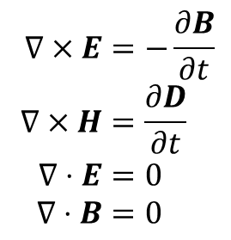


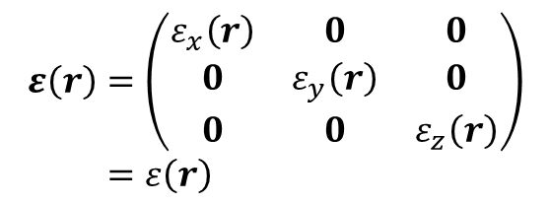



Fiberoptics: EM waves in optical fiber
Maxwell’s equations in free space
③ and if the medium is isotropic,
$$∇×E=−\frac{∂B}{∂t} \\ ∇×H=\frac{∂D}{∂t} \\ ∇⋅E=0 \\ ∇⋅B=0$$
$$ε\left(r\right)=\left(\begin{matrix}ε_{x}\left(r\right) & 0 & 0 \\ 0 & ε_{y}\left(r\right) & 0 \\ 0 & 0 & ε_{z}\left(r\right)\end{matrix}\right) \\ =ε\left(r\right)$$
④ and if the medium is homogeneous,
① If the medium is linear,
$$ε\left(r\right)=ε_{0}\left(1+χ_{0}\right)=ε_{r}ε_{0}=ε$$
$$D=ε_{0}E+P=ε_{0}E+ε_{0}χ\left(r,t\right)E=ε\left(r,t\right)E$$
$$D=εE$$
⑤ and if the medium is non-magnetic,
② and if the medium is non-dispersive,
$$χ\left(r,t\right)=χ\left(r\right)$$
$$B=μ_{0}\left(H+M\right)$$
in other words,
$$M=χ_{m}\left(r,t\right)H$$
$$ε\left(r,t\right)=ε\left(r\right)$$
$$χ_{m}\left(r,t\right)=0$$
$$B=μ_{0}H$$

Slide 8
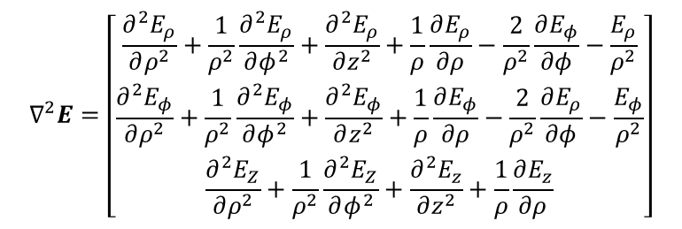
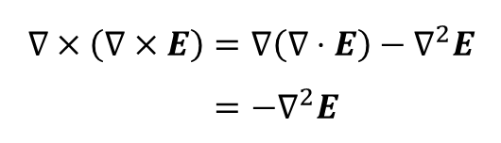
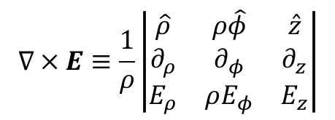
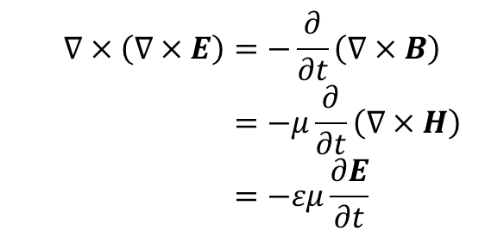


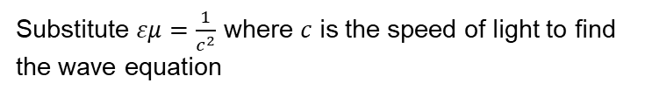
Fiberoptics: EM waves in optical fiber
Maxwell’s equations in free space
In cylindrical coordinates, a vector can be written as,
$$E=E_{ρ}\hat{ρ}+E_{φ}\hat{φ}+E_{z}\hat{z}$$
Applying curl on both sides of the Faraday’s law,
$$∇×\left(∇×E\right)=−\frac{∂}{∂t}\left(∇×B\right) \\ =−μ\frac{∂}{∂t}\left(∇×H\right) \\ =−εμ\frac{∂E}{∂t}$$
and the curl equations are defined as,
$$∇×E≡\frac{1}{ρ}\left|\begin{matrix}\hat{ρ} & ρ\hat{φ} & \hat{z} \\ ∂_{ρ} & ∂_{φ} & ∂_{z} \\ E_{ρ} & ρE_{φ} & E_{z}\end{matrix}\right|$$
Then the vector Laplacian, the left-hand side of the wave equation, is equal to
from the vector identity,
$$∇×\left(∇×E\right)=∇\left(∇⋅E\right)−∇^{2}E \\ =−∇^{2}E$$
$$∇^{2}E=\left[\begin{matrix}\frac{∂^{2}E_{ρ}}{∂ρ^{2}}+\frac{1}{ρ^{2}}\frac{∂^{2}E_{ρ}}{∂φ^{2}}+\frac{∂^{2}E_{ρ}}{∂z^{2}}+\frac{1}{ρ}\frac{∂E_{ρ}}{∂ρ}−\frac{2}{ρ^{2}}\frac{∂E_{φ}}{∂φ}−\frac{E_{ρ}}{ρ^{2}} \\ \frac{∂^{2}E_{φ}}{∂ρ^{2}}+\frac{1}{ρ^{2}}\frac{∂^{2}E_{φ}}{∂φ^{2}}+\frac{∂^{2}E_{φ}}{∂z^{2}}+\frac{1}{ρ}\frac{∂E_{φ}}{∂ρ}−\frac{2}{ρ^{2}}\frac{∂E_{ρ}}{∂φ}−\frac{E_{φ}}{ρ^{2}} \\ \frac{∂^{2}E_{Z}}{∂ρ^{2}}+\frac{1}{ρ^{2}}\frac{∂^{2}E_{Z}}{∂φ^{2}}+\frac{∂^{2}E_{z}}{∂z^{2}}+\frac{1}{ρ}\frac{∂E_{z}}{∂ρ}\end{matrix}\right]$$
Substitute $εμ=\frac{1}{c^{2}}$ where $c$ is the speed of light to find the wave equation
$∇^{2}E=\frac{1}{c^{2}}$ $\frac{∂E}{∂t}$

Slide 9


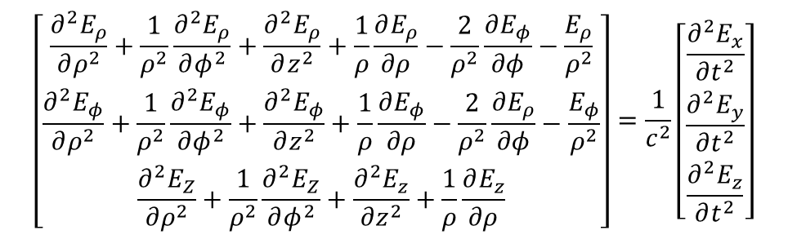
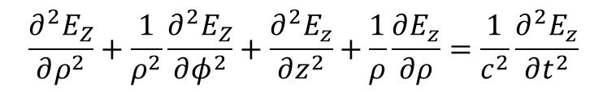
Fiberoptics: EM waves in optical fiber
The wave equation in cylindrical coordinate is then,
$∇^{2}E=\frac{1}{c^{2}}$ $\frac{∂E}{∂t}$
$$\left[\begin{matrix}\frac{∂^{2}E_{ρ}}{∂ρ^{2}}+\frac{1}{ρ^{2}}\frac{∂^{2}E_{ρ}}{∂φ^{2}}+\frac{∂^{2}E_{ρ}}{∂z^{2}}+\frac{1}{ρ}\frac{∂E_{ρ}}{∂ρ}−\frac{2}{ρ^{2}}\frac{∂E_{φ}}{∂φ}−\frac{E_{ρ}}{ρ^{2}} \\ \frac{∂^{2}E_{φ}}{∂ρ^{2}}+\frac{1}{ρ^{2}}\frac{∂^{2}E_{φ}}{∂φ^{2}}+\frac{∂^{2}E_{φ}}{∂z^{2}}+\frac{1}{ρ}\frac{∂E_{φ}}{∂ρ}−\frac{2}{ρ^{2}}\frac{∂E_{ρ}}{∂φ}−\frac{E_{φ}}{ρ^{2}} \\ \frac{∂^{2}E_{Z}}{∂ρ^{2}}+\frac{1}{ρ^{2}}\frac{∂^{2}E_{Z}}{∂φ^{2}}+\frac{∂^{2}E_{z}}{∂z^{2}}+\frac{1}{ρ}\frac{∂E_{z}}{∂ρ}\end{matrix}\right]=\frac{1}{c^{2}}\left[\begin{matrix}\frac{∂^{2}E_{x}}{∂t^{2}} \\ \frac{∂^{2}E_{y}}{∂t^{2}} \\ \frac{∂^{2}E_{z}}{∂t^{2}}\end{matrix}\right]$$
$E_{z}$ can be directly derived from the last equation.
$$\frac{∂^{2}E_{Z}}{∂ρ^{2}}+\frac{1}{ρ^{2}}\frac{∂^{2}E_{Z}}{∂φ^{2}}+\frac{∂^{2}E_{z}}{∂z^{2}}+\frac{1}{ρ}\frac{∂E_{z}}{∂ρ}=\frac{1}{c^{2}}\frac{∂^{2}E_{z}}{∂t^{2}}$$
To use the separation of variables, we assume the factored form for $E_{z}$,
$$E_{z}\left(ρ,φ,z,t\right)=ψ\left(ρ,φ,z\right)T\left(t\right)$$
Substituting this into the above equation, we have

Slide 10


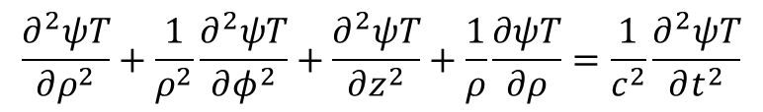
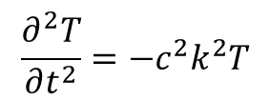
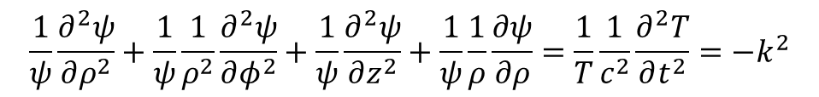

Fiberoptics: EM waves in optical fiber
We have
$$\frac{∂^{2}ψT}{∂ρ^{2}}+\frac{1}{ρ^{2}}\frac{∂^{2}ψT}{∂φ^{2}}+\frac{∂^{2}ψT}{∂z^{2}}+\frac{1}{ρ}\frac{∂ψT}{∂ρ}=\frac{1}{c^{2}}\frac{∂^{2}ψT}{∂t^{2}}$$
Now divide by $ψT$, we have
$$\frac{1}{ψ}\frac{∂^{2}ψ}{∂ρ^{2}}+\frac{1}{ψ}\frac{1}{ρ^{2}}\frac{∂^{2}ψ}{∂φ^{2}}+\frac{1}{ψ}\frac{∂^{2}ψ}{∂z^{2}}+\frac{1}{ψ}\frac{1}{ρ}\frac{∂ψ}{∂ρ}=\frac{1}{T}\frac{1}{c^{2}}\frac{∂^{2}T}{∂t^{2}}=−k^{2}$$
where $k$ is an arbitrary constant. From the last equality, we have
$$\frac{∂^{2}T}{∂t^{2}}=−{c^{2}k}^{2}T$$
$$T\left(t\right)=e^{−iωt}$$
where $ω=ck$.

Slide 11
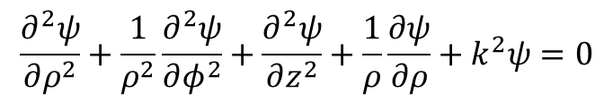


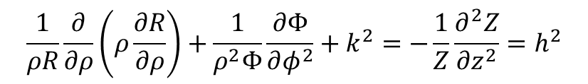
Fiberoptics: EM waves in optical fiber
The first equality is called the Helmholtz equation.
$$\frac{∂^{2}ψ}{∂ρ^{2}}+\frac{1}{ρ^{2}}\frac{∂^{2}ψ}{∂φ^{2}}+\frac{∂^{2}ψ}{∂z^{2}}+\frac{1}{ρ}\frac{∂ψ}{∂ρ}+k^{2}ψ=0$$
To obtain the solution of the Helmholtz equation in cylindrical coordinates, we again assume that
$$ψ\left(ρ,φ,z\right)=R\left(ρ\right)Φ\left(φ\right)Z\left(z\right)$$
Substituting this into the above equation and dividing by $R\left(ρ\right)Φ\left(φ\right)Z\left(z\right)$ yields,
$$\frac{1}{ρR}\frac{∂}{∂ρ}\left(ρ\frac{∂R}{∂ρ}\right)+\frac{1}{ρ^{2}Φ}\frac{∂Φ}{∂φ^{2}}+k^{2}=−\frac{1}{Z}\frac{∂^{2}Z}{∂z^{2}}=h^{2}$$
where $k_{z}$ is constant. From the last equality we have
$$Z\left(z\right)=e^{ihz}$$

Slide 12

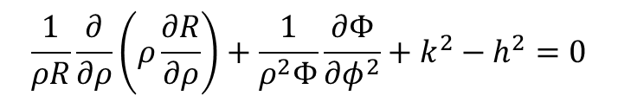
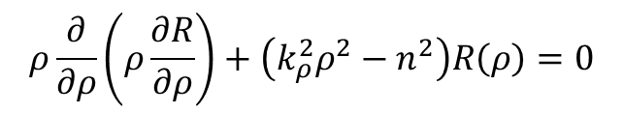

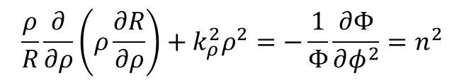
Fiberoptics: EM waves in optical fiber
Now the first equality becomes
$$\frac{1}{ρR}\frac{∂}{∂ρ}\left(ρ\frac{∂R}{∂ρ}\right)+\frac{1}{ρ^{2}Φ}\frac{∂Φ}{∂φ^{2}}+k^{2}−h^{2}=0$$
Letting $k^{2}−h^{2}=k_{ρ}^{2}$ and multiplying $ρ^{2}$ to both sides, we have
$$\frac{ρ}{R}\frac{∂}{∂ρ}\left(ρ\frac{∂R}{∂ρ}\right)+k_{ρ}^{2}ρ^{2}=−\frac{1}{Φ}\frac{∂Φ}{∂φ^{2}}=n^{2}$$
In a manner analogous to the previous procedure,
$$Φ\left(φ\right)=e^{inφ}$$
Note that $n$ must be an integer, since we expect any physical solution to satisfy $e^{inφ}=e^{in\left(φ+2π\right)}$.
Also, we have the $ρ$ equation,
$$ρ\frac{∂}{∂ρ}\left(ρ\frac{∂R}{∂ρ}\right)+\left(k_{ρ}^{2}ρ^{2}−n^{2}\right)R\left(ρ\right)=0$$
It is called Bessel’s differential equation.

Slide 13
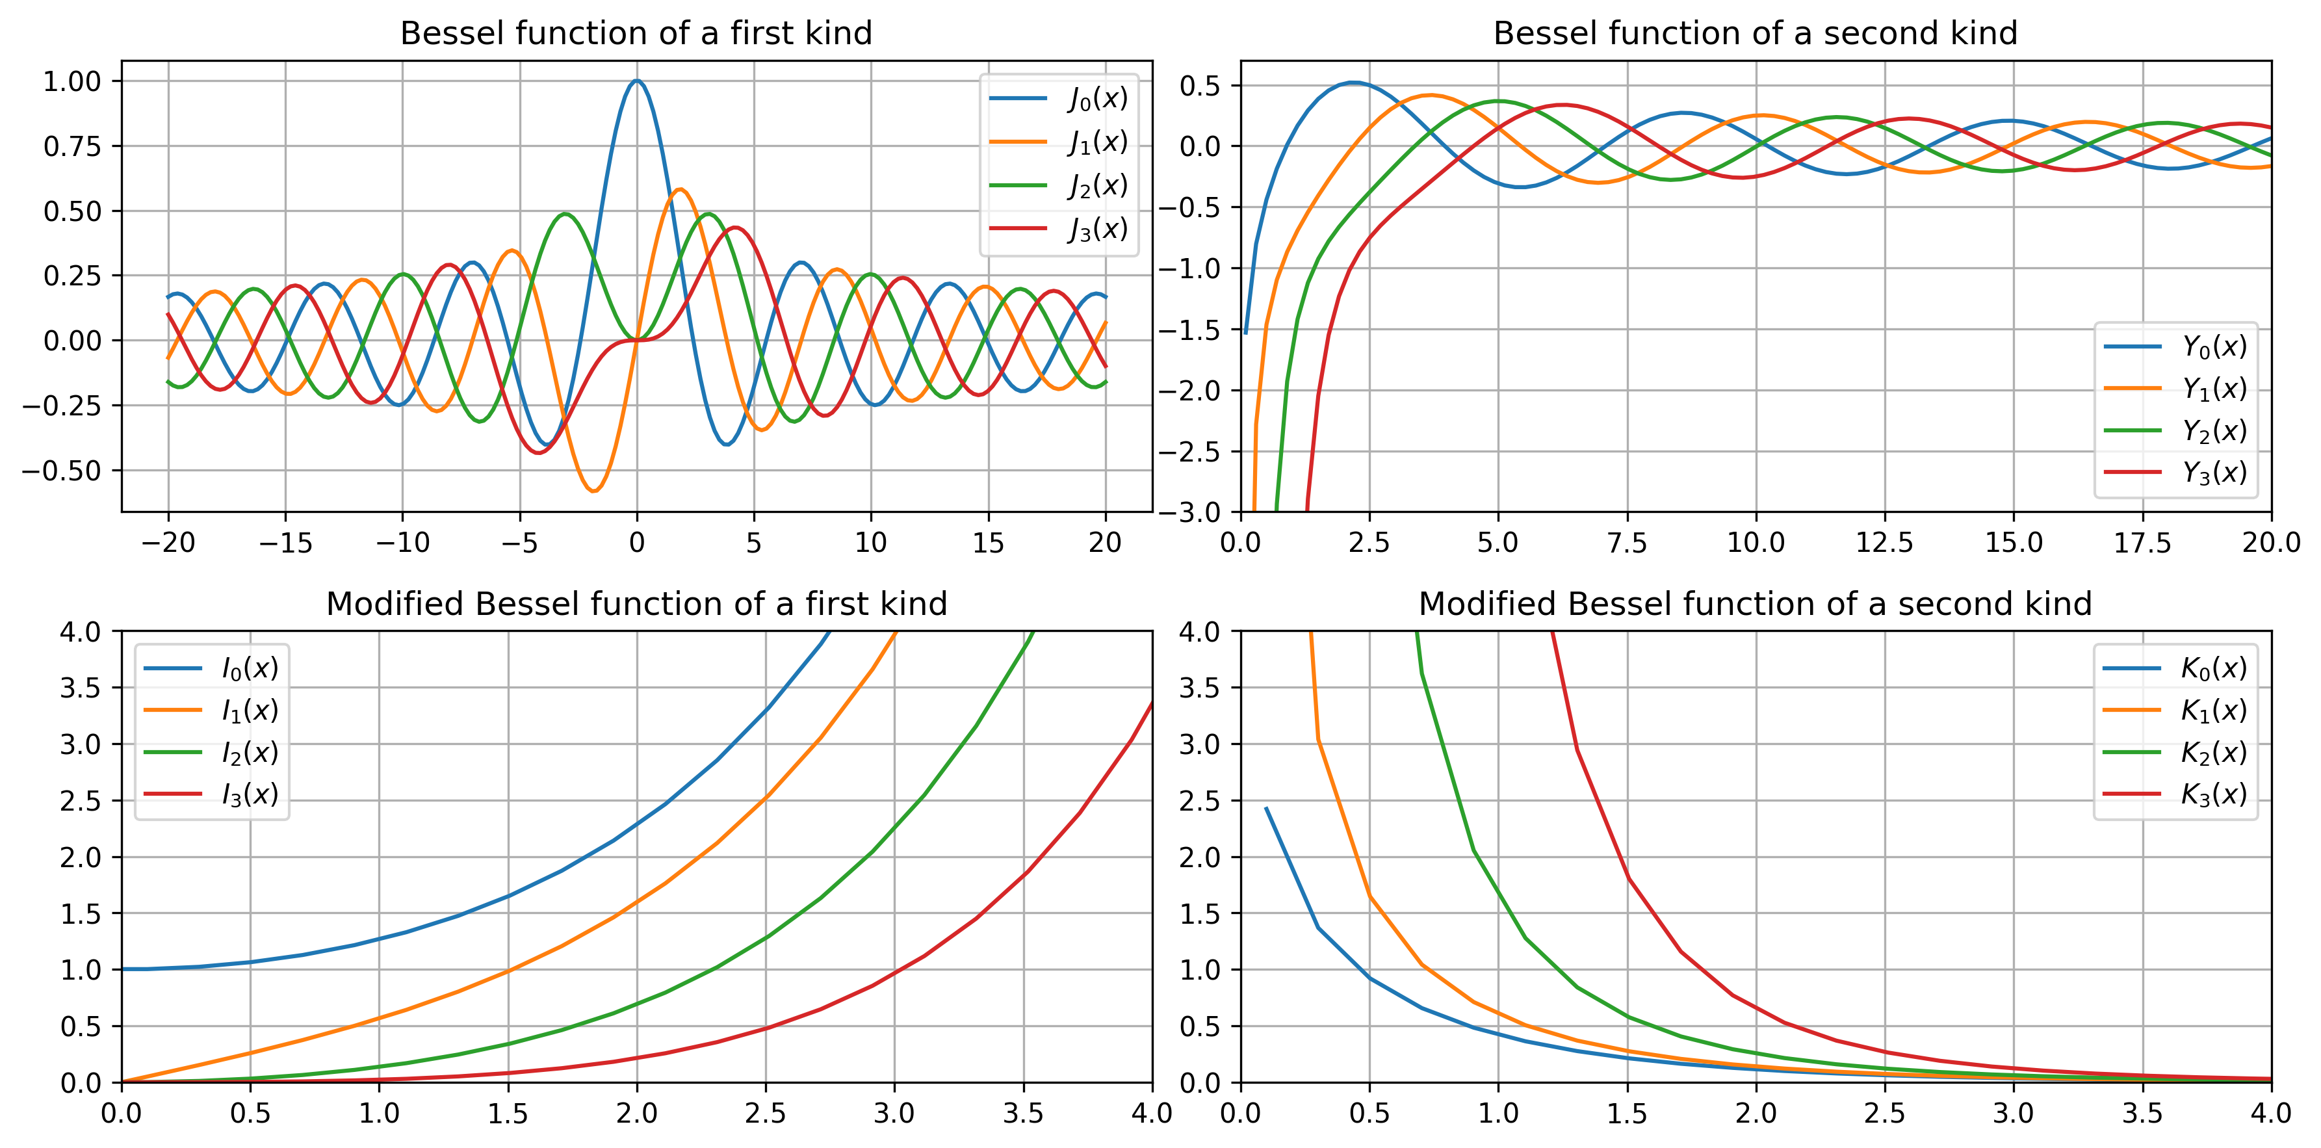










Fiberoptics: EM waves in optical fiber
There are four types of solutions to Bessel’s differential equation.
$$ρ\frac{∂}{∂ρ}\left(ρ\frac{∂R}{∂ρ}\right)+\left(k_{ρ}^{2}ρ^{2}−n^{2}\right)R\left(ρ\right)=0$$
replace $k_{ρ}ρ$ as $x$.
When $k_{ρ}$ is real:
$$J_{α}\left(k_{ρ}ρ\right)=$$
$$Y_{α}\left(k_{ρ}ρ\right)=$$
$$J_{α}\left(x\right)$$
$$Y_{α}\left(x\right)$$
When $k_{ρ}$ is pure imaginary:
$$I_{α}\left(x\right)$$
$$K_{α}\left(x\right)$$

Slide 14
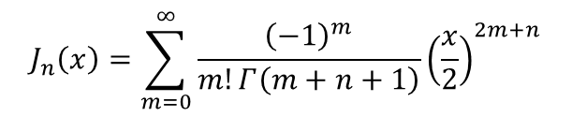


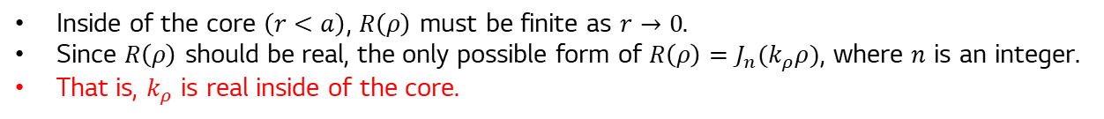






Fiberoptics: EM waves in optical fiber
Remember that $k_{ρ}^{2}+k_{z}^{2}=k^{2}$ and $k=\frac{ω}{c}$
$$J_{n}\left(x\right)=\sum_{m=0}^{∞}{\frac{{\left(−1\right)}^{m}}{m!Γ\left(m+n+1\right)}{\left(\frac{x}{2}\right)}^{2m+n}}$$
$$n_{2}$$
$$Y_{n}\left(x\right)=\frac{J_{n}\left(x\right)\cos\left(nπ\right)−J_{−n}\left(x\right)}{\sin\left(nπ\right)}$$
$$n_{1}$$
$$I_{n}\left(x\right)=i^{−n}J_{n}\left(x\right)$$
$$K_{n}\left(x\right)=\frac{π}{2}\frac{I_{−n}\left(x\right)−I_{n}\left(x\right)}{\sin\left(nπ\right)}$$
The schematic of the step-index optical fiber.
Inside of the core $\left(r<a\right)$, $R\left(ρ\right)$ must be finite as $r→0$.
Since $R\left(ρ\right)$ should be real, the only possible form of $R\left(ρ\right)=J_{n}(k_{ρ}ρ)$, where $n$ is an integer.
That is, $k_{ρ}$ is real inside of the core.
$k_{ρ}^{2}=k^{2}−h^{2}≥0$
$$k_{ρ}∈ℝ, J_{n}\left(x\right)$$
$$k_{ρ}∈ℂ, I_{n}\left(x\right)$$

Slide 15


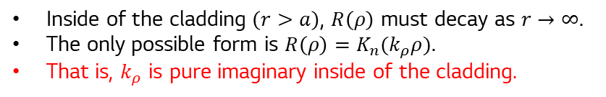
Fiberoptics: EM waves in optical fiber
Remember that $k_{ρ}^{2}+k_{z}^{2}=k^{2}$ and $k=\frac{ω}{c}$
$$J_{n}\left(x\right)=\sum_{m=0}^{∞}{\frac{{\left(−1\right)}^{m}}{m!Γ\left(m+n+1\right)}{\left(\frac{x}{2}\right)}^{2m+n}}$$
$$n_{2}$$
$$Y_{n}\left(x\right)=\frac{J_{n}\left(x\right)\cos\left(nπ\right)−J_{−n}\left(x\right)}{\sin\left(nπ\right)}$$
$$n_{1}$$
$$I_{n}\left(x\right)=i^{−n}J_{n}\left(x\right)$$
$$K_{n}\left(x\right)=\frac{π}{2}\frac{I_{−n}\left(x\right)−I_{n}\left(x\right)}{\sin\left(nπ\right)}$$
The schematic of the step-index optical fiber.
Inside of the cladding $\left(r>a\right)$, $R\left(ρ\right)$ must decay as $r→∞$.
The only possible form is $R\left(ρ\right)=K_{n}(k_{ρ}ρ)$.
That is, $k_{ρ}$ is pure imaginary inside of the cladding.
$$k_{ρ}∈ℂ, K_{n}\left(x\right)$$
$k_{ρ}^{2}=k^{2}−h^{2}≤0$

Slide 16
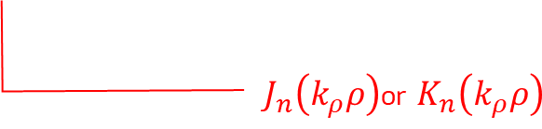



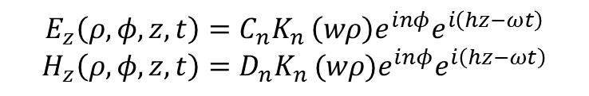


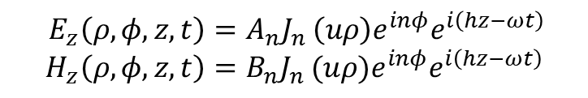

Fiberoptics: EM waves in optical fiber
Recall that by the separation of variables, we assume $E_{z}$ as
$$e^{ihz}$$
$$E_{z}\left(ρ,φ,z,t\right)=R\left(ρ\right)Φ\left(φ\right)Z\left(z\right)T\left(t\right)$$
$$e^{−iωt}$$
$$e^{inφ}$$
$J_{n}\left(k_{ρ}ρ\right)$or $K_{n}\left(k_{ρ}ρ\right)$
Since $k_{ρ}$ has different value in the core and the cladding, we will denote $k_{ρ}\left(ρ<a\right)=u$ $∈ℝ$, and $k_{ρ}\left(ρ>a\right)=w∈ℂ$.
Note that $u^{2}=k_{1}^{2}−h^{2}$ and $w^{2}=h^{2}−k_{2}^{2}$ where $k_{1}=n_{1}k$ and $k_{2}=n_{2}k$.
Inside of the core $\left(ρ<a\right)$
Inside of the cladding $\left(ρ>a\right)$
$$E_{z}\left(ρ,φ,z,t\right)=A_{n}J_{n }\left(uρ\right)e^{inφ}e^{i\left(hz−ωt\right)} \\ H_{z}\left(ρ,φ,z,t\right)=B_{n}J_{n }(uρ)e^{inφ}e^{i\left(hz−ωt\right)}$$
$$E_{z}\left(ρ,φ,z,t\right)={C_{n}K}_{n }\left(wρ\right)e^{inφ}e^{i\left(hz−ωt\right)} \\ H_{z}\left(ρ,φ,z,t\right)={D_{n}K}_{n }(wρ)e^{inφ}e^{i\left(hz−ωt\right)}$$
where $A_{n},B_{n},C_{n}$ and $D_{n}$ are constant coefficients.

Slide 17


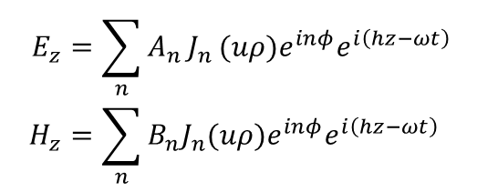
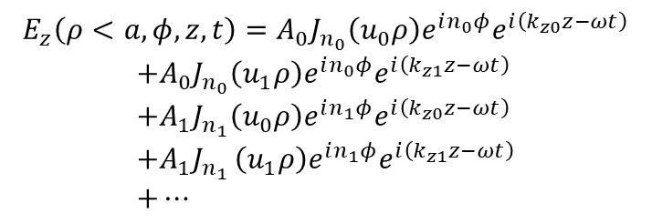
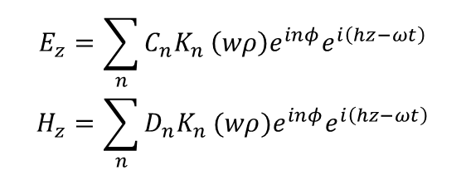
Fiberoptics: EM waves in optical fiber
Since $E_{z}$ with different $n$ and $u$ are orthogonal to each other, $E_{z}\left(H_{z}\right)$ are the linear combination of the above.
$$E_{z}\left(ρ<a,φ,z,t\right)=A_{0}J_{n_{0}}\left(u_{0}ρ\right)e^{in_{0}φ}e^{i\left(k_{z0}z−ωt\right)}$$
$$+A_{0}J_{n_{0}}\left(u_{1}ρ\right)e^{in_{0}φ}e^{i\left(k_{z1}z−ωt\right)} \\ +A_{1}J_{n_{1}}\left(u_{0}ρ\right)e^{in_{1}φ}e^{i\left(k_{z0}z−ωt\right)} \\ +A_{1}J_{n_{1} }\left(u_{1}ρ\right)e^{in_{1}φ}e^{i\left(k_{z1}z−ωt\right)} \\ +…$$
Thus, the most general form of the solution can be constructed as a linear combination of the product solutions:
Inside of the core $\left(ρ<a\right)$
Inside of the cladding $\left(ρ>a\right)$
$$E_{z}=\sum_{n}{A_{n }J_{n }(uρ)e^{inφ}e^{i\left(hz−ωt\right)}} \\ H_{z}=\sum_{n}{B_{n}J_{n}(uρ)e^{inφ}e^{i\left(hz−ωt\right)}}$$
$$E_{z}=\sum_{n}{{C_{n}K}_{n }\left(wρ\right)e^{inφ}e^{i\left(hz−ωt\right)}} \\ H_{z}=\sum_{n}{{D_{n}K}_{n }(wρ)e^{inφ}e^{i\left(hz−ωt\right)}}$$
Note that $h$ in the core is the same as that of the cladding.
Next paper, We will show that the EM fields in the fiber can be separated into $TE$ and $TM$ modes, which are independent to each other.

Slide 18
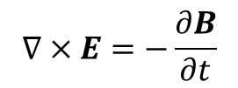
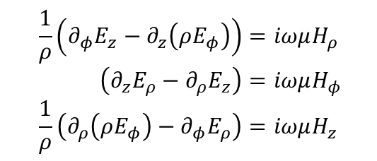
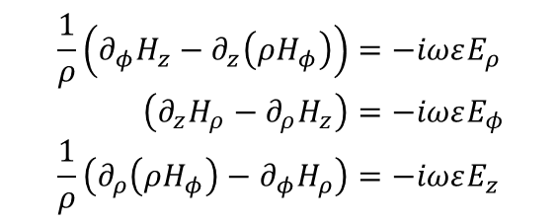
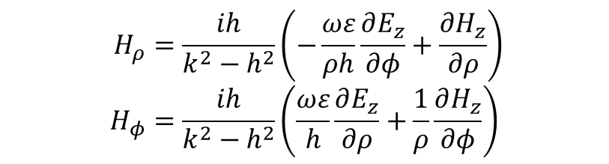
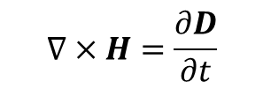
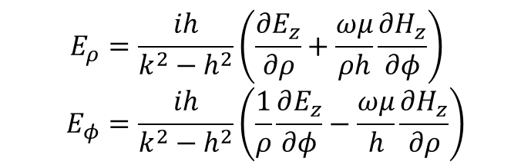
Fiberoptics: EM waves in optical fiber
$E_{r}\left(H_{r}\right)$ and $E_{φ}\left(H_{φ}\right)$ field can be expressed in terms of $E_{z}\left(H_{z}\right).$
$$∇×E=−\frac{∂B}{∂t}$$
$$∇×H=\frac{∂D}{∂t}$$
$$\frac{1}{ρ}\left(∂_{φ}E_{z}−∂_{z}\left(ρE_{φ}\right)\right)=iωμH_{ρ} \\ \left(∂_{z}E_{ρ}−∂_{ρ}E_{z}\right)=iωμH_{φ} \\ \frac{1}{ρ}\left(∂_{ρ}\left(ρE_{φ}\right)−∂_{φ}E_{ρ}\right)=iωμH_{z}$$
$$\frac{1}{ρ}\left(∂_{φ}H_{z}−∂_{z}\left(ρH_{φ}\right)\right)=−iωεE_{ρ} \\ \left(∂_{z}H_{ρ}−∂_{ρ}H_{z}\right)=−iωεE_{φ} \\ \frac{1}{ρ}\left(∂_{ρ}\left(ρH_{φ}\right)−∂_{φ}H_{ρ}\right)=−iωεE_{z}$$
When $E_{z}$ has the factored form, that is, $E_{z}=R\left\{\left(\sqrt{k^{2}−h^{2}}ρ\right)\right\}e^{inφ}e^{i\left(hz−ωt\right)}$,
$$E_{ρ}=\frac{ih}{k^{2}−h^{2}}\left(\frac{∂E_{z}}{∂ρ}+\frac{ωμ}{ρh}\frac{∂H_{z}}{∂φ}\right) \\ E_{φ}=\frac{ih}{k^{2}−h^{2}}\left(\frac{1}{ρ}\frac{∂E_{z}}{∂φ}−\frac{ωμ}{h}\frac{∂H_{z}}{∂ρ}\right)$$
$$H_{ρ}=\frac{ih}{k^{2}−h^{2}}\left(−\frac{ωε}{ρh}\frac{∂E_{z}}{∂φ}+\frac{∂H_{z}}{∂ρ}\right) \\ H_{φ}=\frac{ih}{k^{2}−h^{2}}\left(\frac{ωε}{h}\frac{∂E_{z}}{∂ρ}+\frac{1}{ρ}\frac{∂H_{z}}{∂φ}\right)$$

Slide 19
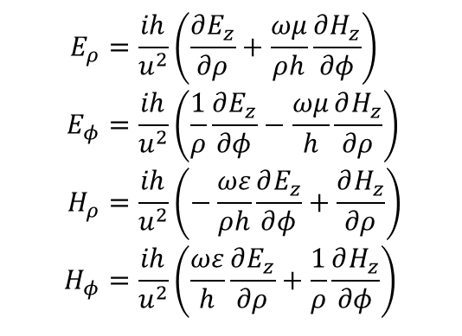
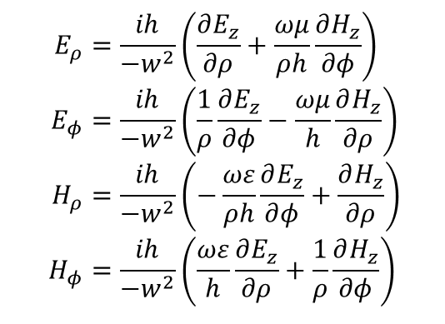


Fiberoptics: EM waves in optical fiber
$E_{r}\left(H_{r}\right)$ and $E_{φ}\left(H_{φ}\right)$ field can be expressed in terms of $E_{z}\left(H_{z}\right).$
$$∇×E=−\frac{∂B}{∂t}$$
$$∇×H=\frac{∂D}{∂t}$$
$$\frac{1}{ρ}\left(∂_{φ}E_{z}−∂_{z}\left(ρE_{φ}\right)\right)=iωμH_{ρ} \\ \left(∂_{z}E_{ρ}−∂_{ρ}E_{z}\right)=iωμH_{φ} \\ \frac{1}{ρ}\left(∂_{ρ}\left(ρE_{φ}\right)−∂_{φ}E_{ρ}\right)=iωμH_{z}$$
$$\frac{1}{ρ}\left(∂_{φ}H_{z}−∂_{z}\left(ρH_{φ}\right)\right)=−iωεE_{ρ} \\ \left(∂_{z}H_{ρ}−∂_{ρ}H_{z}\right)=−iωεE_{φ} \\ \frac{1}{ρ}\left(∂_{ρ}\left(ρH_{φ}\right)−∂_{φ}H_{ρ}\right)=−iωεE_{z}$$
Inside of the core $\left(ρ<a\right)$
Inside of the cladding $\left(ρ>a\right)$
$$E_{ρ}=\frac{ih}{u^{2}}\left(\frac{∂E_{z}}{∂ρ}+\frac{ωμ}{ρh}\frac{∂H_{z}}{∂φ}\right) \\ E_{φ}=\frac{ih}{u^{2}}\left(\frac{1}{ρ}\frac{∂E_{z}}{∂φ}−\frac{ωμ}{h}\frac{∂H_{z}}{∂ρ}\right) \\ H_{ρ}=\frac{ih}{u^{2}}\left(−\frac{ωε}{ρh}\frac{∂E_{z}}{∂φ}+\frac{∂H_{z}}{∂ρ}\right) \\ H_{φ}=\frac{ih}{u^{2}}\left(\frac{ωε}{h}\frac{∂E_{z}}{∂ρ}+\frac{1}{ρ}\frac{∂H_{z}}{∂φ}\right)$$
$$E_{ρ}=\frac{ih}{−w^{2}}\left(\frac{∂E_{z}}{∂ρ}+\frac{ωμ}{ρh}\frac{∂H_{z}}{∂φ}\right) \\ E_{φ}=\frac{ih}{−w^{2}}\left(\frac{1}{ρ}\frac{∂E_{z}}{∂φ}−\frac{ωμ}{h}\frac{∂H_{z}}{∂ρ}\right) \\ H_{ρ}=\frac{ih}{−w^{2}}\left(−\frac{ωε}{ρh}\frac{∂E_{z}}{∂φ}+\frac{∂H_{z}}{∂ρ}\right) \\ H_{φ}=\frac{ih}{−w^{2}}\left(\frac{ωε}{h}\frac{∂E_{z}}{∂ρ}+\frac{1}{ρ}\frac{∂H_{z}}{∂φ}\right)$$

Slide 20
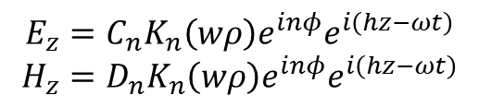

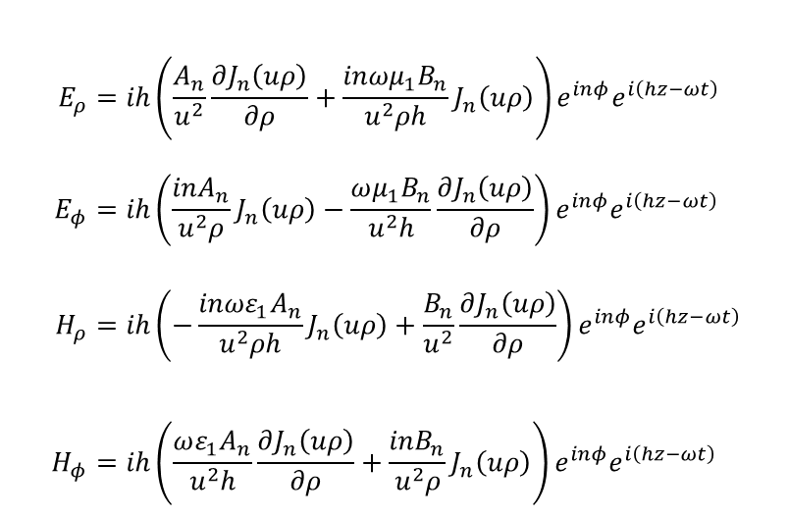
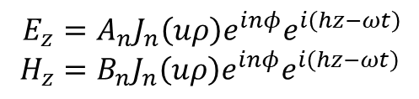


Fiberoptics: EM waves in optical fiber
Obtain $E_{ρ},E_{φ},H_{ρ}$ and $H_{φ}$ by using the elementary form of $E_{z}$ and $H_{z}$.
Inside of the core $\left(ρ<a\right)$
Inside of the cladding $\left(ρ>a\right)$
$$E_{z}=A_{n}J_{n}\left(uρ\right)e^{inφ}e^{i\left(hz−ωt\right)} \\ H_{z}=B_{n}J_{n}\left(uρ\right)e^{inφ}e^{i\left(hz−ωt\right)}$$
$$E_{z}=C_{n}K_{n}\left(wρ\right)e^{inφ}e^{i\left(hz−ωt\right)} \\ H_{z}=D_{n}K_{n}\left(wρ\right)e^{inφ}e^{i\left(hz−ωt\right)}$$
$$E_{ρ}=ih\left(\frac{A_{n}}{u^{2}}\frac{∂J_{n}\left(uρ\right)}{∂ρ}+\frac{inωμ_{1}B_{n}}{u^{2}ρh}J_{n}\left(uρ\right)\right)e^{inφ}e^{i\left(hz−ωt\right)} \\ E_{φ}=ih\left(\frac{inA_{n}}{u^{2}ρ}J_{n}\left(uρ\right)−\frac{ωμ_{1}B_{n}}{u^{2}h}\frac{∂J_{n}\left(uρ\right)}{∂ρ}\right)e^{inφ}e^{i\left(hz−ωt\right)} \\ H_{ρ}=ih\left(−\frac{inωε_{1}A_{n}}{u^{2}ρh}J_{n}\left(uρ\right)+\frac{B_{n}}{u^{2}}\frac{∂J_{n}\left(uρ\right)}{∂ρ}\right)e^{inφ}e^{i\left(hz−ωt\right)} \\ H_{φ}=ih\left(\frac{ωε_{1}A_{n}}{u^{2}h}\frac{∂J_{n}\left(uρ\right)}{∂ρ}+\frac{inB_{n}}{u^{2}ρ}J_{n}\left(uρ\right)\right)e^{inφ}e^{i\left(hz−ωt\right)}$$
$$E_{ρ}=−ih\left(\frac{C_{n}}{w^{2}}\frac{∂K_{n}\left(wρ\right)}{∂ρ}+\frac{inωμ_{2}D_{n}}{w^{2}ρh}K_{n}\left(wρ\right)\right)e^{inφ}e^{i\left(hz−ωt\right)} \\ E_{φ}=−ih\left(\frac{inC_{n}}{w^{2}ρ}K_{n}\left(wρ\right)−\frac{ωμ_{2}D_{n}}{w^{2}h}\frac{∂K_{n}\left(wρ\right)}{∂ρ}\right)e^{inφ}e^{i\left(hz−ωt\right)} \\ H_{ρ}=−ih\left(−\frac{inωε_{2}C_{n}}{w^{2}ρh}K_{n}\left(wρ\right)+\frac{D_{n}}{w^{2}}\frac{∂K_{n}\left(wρ\right)}{∂ρ}\right)e^{inφ}e^{i\left(hz−ωt\right)} \\ H_{φ}=−ih\left(\frac{ωε_{2}C_{n}}{w^{2}h}\frac{∂K_{n}\left(wρ\right)}{∂ρ}+\frac{inD_{n}}{w^{2}ρ}K_{n}\left(wρ\right)\right)e^{inφ}e^{i\left(hz−ωt\right)}$$

Slide 21








Fiberoptics: EM waves in optical fiber
Since the transverse components of the $E$ and $H$ fields are continuous at $r=a$,
$$\lim_{ρ→r−0}{E_{z}\left(ρ<a\right)}=\lim_{ρ→r+0}{E_{z}\left(ρ>a\right)} \\ \lim_{ρ→r−0}{E_{φ}\left(ρ<a\right)}=\lim_{ρ→r+0}{E_{φ}\left(ρ>a\right)}$$
$$\lim_{ρ→r−0}{H_{z}\left(ρ<a\right)}=\lim_{ρ→r+0}{H_{z}\left(ρ>a\right)} \\ \lim_{ρ→r−0}{H_{φ}\left(ρ<a\right)}=\lim_{ρ→r+0}{H_{φ}\left(ρ>a\right)}$$
$$A_{n}J_{n }\left(ua\right)=C_{n}K_{n}\left(wa\right)$$
$${B_{n}}_{ }J_{n}\left(ua\right)=D_{n}K_{n}\left(wa\right)$$
$$\left(\frac{in}{u^{2}a}A_{n}J_{n}\left(ua\right)−\frac{ωμ_{1}}{u^{2}h}B_{n}{\left.\frac{∂J_{n}\left(uρ\right)}{∂ρ}\right|}_{ρ=a}\right)$$
$$=−\left(\frac{in}{w^{2}a}C_{n}K_{n}\left(wa\right)−\frac{ωμ_{2}}{w^{2}h}D_{n}{\left.\frac{∂K_{n}\left(wρ\right)}{∂ρ}\right|}_{ρ=a}\right)$$
$$\left(\frac{ωε_{1}}{u^{2}h}A_{n}{\left.\frac{∂J_{n}\left(uρ\right)}{∂ρ}\right|}_{ρ=a}+\frac{in}{u^{2}a}B_{n}J_{n}\left(uρ\right)\right)$$
$$=−\left(\frac{ωε_{2}}{w^{2}h}C_{n}{\left.\frac{∂K_{n}\left(wρ\right)}{∂ρ}\right|}_{ρ=a}+\frac{in}{w^{2}a}D_{n}K_{n}\left(wρ\right)\right)$$
$$\frac{inh}{ωa}A_{n}\left(\frac{1}{u^{2}}+\frac{1}{w^{2}}\right)=B_{n}\left(\frac{μ_{2}}{w^{2}K_{n}\left(wa\right)}{\left.\frac{∂K_{n}\left(wρ\right)}{∂ρ}\right|}_{ρ=a}+\frac{μ_{1}}{u^{2}J_{n}\left(ua\right)}{\left.\frac{∂J_{n}\left(uρ\right)}{∂ρ}\right|}_{ρ=a}\right)$$
$$\frac{inh}{ωa}B_{n}\left(\frac{1}{w^{2}}+\frac{1}{u^{2}}\right)=−A_{n}\left(\frac{ε_{1}}{u^{2}}\frac{1}{J_{n}\left(ua\right)}{\left.\frac{∂J_{n}\left(uρ\right)}{∂ρ}\right|}_{ρ=a}+\frac{ε_{2}}{w^{2}}\frac{1}{K_{n}\left(wa\right)}{\left.\frac{∂K_{n}\left(wρ\right)}{∂ρ}\right|}_{ρ=a}\right)$$

Slide 22





Fiberoptics: EM waves in optical fiber
Since ${\left.\frac{∂K_{n}\left(wρ\right)}{∂ρ}\right|}_{ρ=a}=wK_{n}^{′}\left(wa\right)$ and ${\left.\frac{∂J_{n}\left(uρ\right)}{∂ρ}\right|}_{ρ=a}=wJ_{n}^{′}\left(ua\right)$, the above equations can be rewritten as,
$$\frac{inh}{ωa}A_{n}\left(\frac{1}{u^{2}}+\frac{1}{w^{2}}\right)=B_{n}\left(\frac{μ_{2}K_{n}^{′}\left(wa\right)}{wK_{n}\left(wa\right)}+\frac{μ_{1}J_{n}^{′}\left(ua\right)}{uJ_{n}\left(ua\right)}\right) \\ \frac{−inh}{ωa}B_{n}\left(\frac{1}{w^{2}}+\frac{1}{u^{2}}\right)=A_{n}\left(\frac{ε_{1}}{u}\frac{J_{n}^{′}\left(ua\right)}{J_{n}\left(ua\right)}+\frac{ε_{2}K_{n}^{′}\left(wa\right)}{wK_{n}\left(wa\right)}\right)$$
Further, define $η_{1}=\frac{1}{ua}\frac{J_{n}^{′}\left(wa\right)}{J_{n}\left(ua\right)}$ and $η_{2}=\frac{K_{n}^{′}\left(wa\right)}{waK_{n}\left(wa\right)}$
$$\frac{inh}{ωa^{2}}A_{n}\left(\frac{1}{u^{2}}+\frac{1}{w^{2}}\right)=B_{n}\left(μ_{2}η_{2}+μ_{1}η_{1}\right) \\ \frac{−inh}{ωa^{2}}B_{n}\left(\frac{1}{w^{2}}+\frac{1}{u^{2}}\right)=A_{n}\left(ε_{1}η_{1}+ε_{2}η_{2}\right)$$
Combining the two equations yields,
$${\left(\frac{nh}{a^{2}}\right)}^{2}{\left(\frac{1}{u^{2}}+\frac{1}{w^{2}}\right)}^{2}=ω^{2}\left(ε_{1}η_{1}+ε_{2}η_{2}\right)\left(μ_{1}η_{1}+μ_{2}η_{2}\right)$$

Slide 23


Fiberoptics: EM waves in optical fiber
Recall that we assume non-magnetic material, $μ_{1}=μ_{2}=μ_{0}$. Then we have
$${\left(nh\right)}^{2}{\left\{\frac{1}{{\left(ua\right)}^{2}}+\frac{1}{{\left(wa\right)}^{2}}\right\}}^{2}=ω^{2}μ_{0}\left(ε_{1}η_{1}+ε_{2}η_{2}\right)\left(η_{1}+η_{2}\right) \\ =\left(k_{1}^{2}η_{1}+k_{2}^{2}η_{2}\right)\left(η_{1}+η_{2}\right)$$
since $u^{2}=k_{1}^{2}−h^{2}≥0$ and $w^{2}=h^{2}−k_{2}^{2}≥0$, the range of $h$ is,
$$k_{2}≤h≤k_{1}$$
Both equations determine the value of $h$ in a step-index optical fiber, along with $n$.
As we can see, $h$ cannot be determined analytically but numerically.

Slide 24







Fiberoptics: EM waves in optical fiber
$${\left(nh\right)}^{2}{\left\{\frac{1}{{\left(ua\right)}^{2}}+\frac{1}{{\left(wa\right)}^{2}}\right\}}^{2}=\left(k_{1}^{2}η_{1}+k_{2}^{2}η_{2}\right)\left(η_{1}+η_{2}\right)$$
$$a=8 μm \\ λ=940 nm \\ n_{1}=1.46 \\ n_{2}=1.44$$
When $n=0$, there are $4$ possible $h$ values.
Also, $TE$ and $TM$ polarizations are distinguished. So, there are 8 modes.
$TE_{01}$ or $TM_{01}$ mode
$TE_{02}$ or $TM_{02}$ mode
$$k_{2}$$
$$k_{1}$$

Slide 25







Fiberoptics: EM waves in optical fiber
When $\left|n\right|>0$, $E_{z}$ and $H_{z}$ are non-zero, as we can see from the equation,
$$\frac{inh}{ωa^{2}}A_{n}\left(\frac{1}{u^{2}}+\frac{1}{w^{2}}\right)=B_{n}\left(μ_{2}η_{2}+μ_{1}η_{1}\right) \\ \frac{−inh}{ωa^{2}}B_{n}\left(\frac{1}{w^{2}}+\frac{1}{u^{2}}\right)=A_{n}\left(ε_{1}η_{1}+ε_{2}η_{2}\right)$$
If $n≠0$, then $A_{n}$ and $B_{n}$ must be non-zero. If one of them is zero, then the other one must be zero to hold the two equations.
$n=1$: 7 modes
$n=5$: 5 modes
$n=9$: 1 modes

Slide 26













































Fiberoptics: EM waves in optical fiber
$$α=3$$
$$e^{i3φ}={−e}^{i3\left(φ+\frac{π}{3}\right)}$$
$$LP_{31}$$
$$LP_{32}$$
$$LP_{33}$$
$$α=2$$
$$e^{i2φ}={−e}^{i2\left(φ+\frac{π}{2}\right)}$$
$$LP_{21}$$
$$LP_{22}$$
$$LP_{23}$$
$$α=1$$
$$e^{iφ}={−e}^{i\left(φ+π\right)}$$
$$LP_{11}$$
$$LP_{12}$$
$$LP_{13}$$
$$LP_{14}$$
$$\hat{ρ}$$
$$φ$$
$$\hat{φ}$$
$$α=0$$
No $φ$ dependence.
$$LP_{01}$$
$$LP_{02}$$
$$LP_{03}$$
$$LP_{04}$$
$$k_{ρ1}$$
$$k_{ρ2}$$
$$k_{ρ3}$$
$$k_{ρ4}$$
$$k_{ρ5}$$
Figure from: https://www.rp-photonics.com/lp_modes.html

Slide 27






Geometric optics vs Electromagnetics in optical fiber
Geometric optics
Electromagnetics
$$LP_{11}$$
$$LP_{12}$$
$$LP_{01}$$
$$LP_{02}$$
$$λ=940 nm$$ $a=8 μm→$ 43 개 모드
$a=100 μm→$ > 400 개 모드
Geometric optics is not the exact description of the EM waves in optical fiber.
Rays like in the left figure are superpositions of modes that are shown in the right figure.
The geometric-optical approach is only valid when the diameter of the core is longer than $8 μm$.
It describes only the plane-wave-like characteristic of light.
It does not consider the interference and diffraction between the plane-wave-like characteristics.

Slide 28
Fiberoptics: EM waves in optical fiber
Reference
[1] Snitzer, E. (1961). Cylindrical Dielectric Waveguide Modes. Journal of the Optical Society of America, 51(5), 491. https://doi.org/10.1364/josa.51.000491
[2] G. Arfken and H. Weber, Mathematical Methods for Physicists. London: Academic Press (1995)
[3] Jackson, J. D. (1999). Classical electrodynamics.
[4] Kasap, S. (2013). Optoelectronics & photonics: principles & practices: international edition. Pearson.
[5] Hecht, E. (2012). Optics. Pearson Education India.
[6] Senior, J. M., & Jamro, M. Y. (2009). Optical fiber communications: principles and practice. Pearson Education.
[7] https://www.rp-photonics.com/lp_modes.html
[8] https://www.rp-photonics.com/modes.html

Slide 29



Fiberoptics: EM waves in optical fiber
The step-index fiber
Maxwell’s equations in free space
$$∇×E=−\frac{∂B}{∂t} \\ ∇×H=\frac{∂D}{∂t} \\ ∇⋅E=0 \\ ∇⋅B=0$$
The schematic of the step-index optical fiber.
① If the medium is linear,
Cylindrical Coordinate
② and if the medium is non-dispersive,
③ and if the medium is isotropic,
④ and if the medium is homogeneous,
EM wave in an optical fiber should be described by solving Maxwell’s equations.
⑤ and if the medium is non-magnetic,
$$D=ε_{0}E+P \\ =ε_{0}E+ε_{0}χ\left(r,t\right)E \\ =ε_{0}\left(1+χ_{0}\right)E \\ =ε_{0}ε_{r}E$$
$$B=μ_{0}H$$

Slide 30






Fiberoptics: EM waves in optical fiber
Maxwell’s equations in free space
$$∇×\left(∇×E\right)=−\frac{∂}{∂t}\left(∇×B\right) \\ ∇\left(∇⋅E\right)−∇^{2}E=−μ\frac{∂}{∂t}\left(∇×H\right) \\ −∇^{2}E=−εμ\frac{∂E}{∂t} \\ ∇^{2}E=\frac{1}{c^{2}} \frac{∂E}{∂t}$$
$$\left[\begin{matrix}\frac{∂^{2}E_{ρ}}{∂ρ^{2}}+\frac{1}{ρ^{2}}\frac{∂^{2}E_{ρ}}{∂φ^{2}}+\frac{∂^{2}E_{ρ}}{∂z^{2}}+\frac{1}{ρ}\frac{∂E_{ρ}}{∂ρ}−\frac{2}{ρ^{2}}\frac{∂E_{φ}}{∂φ}−\frac{E_{ρ}}{ρ^{2}} \\ \frac{∂^{2}E_{φ}}{∂ρ^{2}}+\frac{1}{ρ^{2}}\frac{∂^{2}E_{φ}}{∂φ^{2}}+\frac{∂^{2}E_{φ}}{∂z^{2}}+\frac{1}{ρ}\frac{∂E_{φ}}{∂ρ}−\frac{2}{ρ^{2}}\frac{∂E_{ρ}}{∂φ}−\frac{E_{φ}}{ρ^{2}} \\ \frac{∂^{2}E_{Z}}{∂ρ^{2}}+\frac{1}{ρ^{2}}\frac{∂^{2}E_{Z}}{∂φ^{2}}+\frac{∂^{2}E_{z}}{∂z^{2}}+\frac{1}{ρ}\frac{∂E_{z}}{∂ρ}\end{matrix}\right]=\frac{1}{c^{2}}\left[\begin{matrix}\frac{∂^{2}E_{x}}{∂t^{2}} \\ \frac{∂^{2}E_{y}}{∂t^{2}} \\ \frac{∂^{2}E_{z}}{∂t^{2}}\end{matrix}\right]$$
Inside of the core $\left(ρ<a\right)$
Inside of the cladding $\left(ρ>a\right)$
$$E_{z}=\sum_{n}{A_{n }J_{n }(uρ)e^{inφ}e^{i\left(hz−ωt\right)}} \\ H_{z}=\sum_{n}{B_{n}J_{n}(uρ)e^{inφ}e^{i\left(hz−ωt\right)}} \\ E_{ρ}=ih\left(\frac{A_{n}}{u^{2}}\frac{∂J_{n}\left(uρ\right)}{∂ρ}+\frac{inωμ_{1}B_{n}}{u^{2}ρh}J_{n}\left(uρ\right)\right)e^{inφ}e^{i\left(hz−ωt\right)} \\ E_{φ}=ih\left(\frac{inA_{n}}{u^{2}ρ}J_{n}\left(uρ\right)−\frac{ωμ_{1}B_{n}}{u^{2}h}\frac{∂J_{n}\left(uρ\right)}{∂ρ}\right)e^{inφ}e^{i\left(hz−ωt\right)} \\ H_{ρ}=ih\left(−\frac{inωε_{1}A_{n}}{u^{2}ρh}J_{n}\left(uρ\right)+\frac{B_{n}}{u^{2}}\frac{∂J_{n}\left(uρ\right)}{∂ρ}\right)e^{inφ}e^{i\left(hz−ωt\right)} \\ H_{φ}=ih\left(\frac{ωε_{1}A_{n}}{u^{2}h}\frac{∂J_{n}\left(uρ\right)}{∂ρ}+\frac{inB_{n}}{u^{2}ρ}J_{n}\left(uρ\right)\right)e^{inφ}e^{i\left(hz−ωt\right)}$$
$$E_{z}=\sum_{n}{{C_{n}K}_{n }\left(wρ\right)e^{inφ}e^{i\left(hz−ωt\right)}} \\ H_{z}=\sum_{n}{{D_{n}K}_{n }(wρ)e^{inφ}e^{i\left(hz−ωt\right)}} \\ E_{ρ}=−ih\left(\frac{C_{n}}{w^{2}}\frac{∂K_{n}\left(wρ\right)}{∂ρ}+\frac{inωμ_{2}D_{n}}{w^{2}ρh}K_{n}\left(wρ\right)\right)e^{inφ}e^{i\left(hz−ωt\right)} \\ E_{φ}=−ih\left(\frac{inC_{n}}{w^{2}ρ}K_{n}\left(wρ\right)−\frac{ωμ_{2}D_{n}}{w^{2}h}\frac{∂K_{n}\left(wρ\right)}{∂ρ}\right)e^{inφ}e^{i\left(hz−ωt\right)} \\ H_{ρ}=−ih\left(−\frac{inωε_{2}C_{n}}{w^{2}ρh}K_{n}\left(wρ\right)+\frac{D_{n}}{w^{2}}\frac{∂K_{n}\left(wρ\right)}{∂ρ}\right)e^{inφ}e^{i\left(hz−ωt\right)} \\ H_{φ}=−ih\left(\frac{ωε_{2}C_{n}}{w^{2}h}\frac{∂K_{n}\left(wρ\right)}{∂ρ}+\frac{inD_{n}}{w^{2}ρ}K_{n}\left(wρ\right)\right)e^{inφ}e^{i\left(hz−ωt\right)}$$

Slide 31









Fiberoptics: EM waves in optical fiber
$k_{2}<h<k_{1}$
${\left(nh\right)}^{2}{\left\{\frac{1}{{\left(ua\right)}^{2}}+\frac{1}{{\left(wa\right)}^{2}}\right\}}^{2}=\left(k_{1}^{2}η_{1}+k_{2}^{2}η_{2}\right)\left(η_{1}+η_{2}\right)$
where $u^{2}=k_{1}^{2}−h^{2}$ and $w^{2}=h^{2}−k_{2}^{2}$.
$TE_{01}$ or $TM_{01}$ mode
$TE_{02}$ or $TM_{02}$ mode
When $\left|n\right|>0$, $E_{z}$ and $H_{z}$ are non-zero, as we can see from the equation,
$$\frac{inh}{ωa^{2}}A_{n}\left(\frac{1}{u^{2}}+\frac{1}{w^{2}}\right)=B_{n}\left(μ_{2}η_{2}+μ_{1}η_{1}\right) \\ \frac{−inh}{ωa^{2}}B_{n}\left(\frac{1}{w^{2}}+\frac{1}{u^{2}}\right)=A_{n}\left(ε_{1}η_{1}+ε_{2}η_{2}\right)$$
If $n≠0$, then $A_{n}$ and $B_{n}$ must be non-zero. If one of them is zero, then the other one must be zero to hold the two equations.
$$a=8 μm \\ λ=940 nm \\ n_{1}=1.46 \\ n_{2}=1.44$$
$n=0$: 8 modes
$n=1$: 7 modes
$n=5$: 5 modes
$n=9$: 1 modes

Slide 32
Fiberoptics: EM waves in optical fiber
$$α=3$$
$$e^{i3φ}={−e}^{i3\left(φ+\frac{π}{3}\right)}$$
$$LP_{31}$$
$$LP_{32}$$
$$LP_{33}$$
$$α=2$$
$$e^{i2φ}={−e}^{i2\left(φ+\frac{π}{2}\right)}$$
$$LP_{21}$$
$$LP_{22}$$
$$LP_{23}$$
$$α=1$$
$$e^{iφ}={−e}^{i\left(φ+π\right)}$$
$$LP_{11}$$
$$LP_{12}$$
$$LP_{13}$$
$$LP_{14}$$
$$\hat{ρ}$$
$$φ$$
$$\hat{φ}$$
$$α=0$$
No $φ$ dependence.
$$LP_{01}$$
$$LP_{02}$$
$$LP_{03}$$
$$LP_{04}$$
$$k_{ρ1}$$
$$k_{ρ2}$$
$$k_{ρ3}$$
$$k_{ρ4}$$
$$k_{ρ5}$$
Figure from: https://www.rp-photonics.com/lp_modes.html

Slide 33

Geometric optics vs Electromagnetics in optical fiber
Geometric optics
Electromagnetics
$$LP_{11}$$
$$LP_{12}$$
$$LP_{01}$$
$$LP_{02}$$
$$λ=940 nm$$ $a=8 μm→$ 43 개 모드
$a=100 μm→$ > 400 개 모드
Geometric optics is not the exact description of the EM waves in optical fiber.
Rays like in the left figure are superpositions of modes, which are shown in the right figure.
The geometric optics approach is only valid when the diameter of the core is longer than $8 μm$.
It describes only the plane-wave-like characteristic of light.
It does not consider the interference between the plane-wave-like characteristics.

Slide 34

Fiberoptics: EM waves in optical fiber
Now the first equality becomes
$$\frac{1}{ρR}\frac{∂}{∂ρ}\left(ρ\frac{∂R}{∂ρ}\right)+\frac{1}{ρ^{2}Φ}\frac{∂Φ}{∂φ^{2}}+k^{2}−h^{2}=0$$
Letting $k^{2}−h^{2}=k_{ρ}^{2}$ and multiplying $ρ^{2}$ to both sides, we have
$$\frac{ρ}{R}\frac{∂}{∂ρ}\left(ρ\frac{∂R}{∂ρ}\right)+k_{ρ}^{2}ρ^{2}=−\frac{1}{Φ}\frac{∂Φ}{∂φ^{2}}=n^{2}$$
In a manner analogous to the previous procedure,
$$Φ\left(φ\right)=Ce^{inφ}=e^{i\left(nφ+ψ_{n}\right)}$$
Note that $n$ must be an integer, since we expect any physical solution to satisfy $e^{inφ}=e^{in\left(φ+2π\right)}$.
Also, we have the $ρ$ equation,
$$ρ\frac{∂}{∂ρ}\left(ρ\frac{∂R}{∂ρ}\right)+\left(k_{ρ}^{2}ρ^{2}−n^{2}\right)R\left(ρ\right)=0$$
It is called Bessel’s differential equation.

Slide 35




Fiberoptics: EM waves in optical fiber
Recall that by the separation of variables, we assume $E_{z}$ as
$$e^{ihz}$$
$$E_{z}\left(ρ,φ,z,t\right)=R\left(ρ\right)Φ\left(φ\right)Z\left(z\right)T\left(t\right)$$
$$e^{−iωt}$$
$$e^{i\left(nφ+ψ_{n}\right)}$$
$J_{n}(uρ)$ or $K_{n}(wρ)$
Since $k_{ρ}$ has different value in the core and the cladding, we will denote $k_{ρ}\left(ρ<a\right)=u$ $∈ℝ$, and $k_{ρ}\left(ρ>a\right)=w∈ℂ$.
Note that $u^{2}=k_{1}^{2}−k_{z}^{2}$ and $w^{2}=k_{z}^{2}−k_{2}^{2}$ where $k_{1}=n_{1}k$ and $k_{2}=n_{2}k$.
Inside of the core $\left(ρ<a\right)$
Inside of the cladding $\left(ρ>a\right)$
$$E_{z}\left(ρ,φ,z,t\right)=A_{n}J_{n }\left(uρ\right)e^{i\left(nφ+ψ_{n}\right)}e^{i\left(hz−ωt\right)} \\ H_{z}\left(ρ,φ,z,t\right)=B_{n}J_{n }(uρ)e^{i\left(nφ+θ_{n}\right)}e^{i\left(hz−ωt\right)}$$
$$E_{z}\left(ρ,φ,z,t\right)={C_{n}K}_{n }\left(wρ\right)e^{i\left(nφ+ψ_{n}\right)}e^{i\left(hz−ωt\right)} \\ H_{z}\left(ρ,φ,z,t\right)={D_{n}K}_{n }(wρ)e^{i\left(nφ+θ_{n}\right)}e^{i\left(hz−ωt\right)}$$
where $A_{n},B_{n},C_{n}$ and $D_{n}$ are constant coefficients.

Slide 36




Fiberoptics: EM waves in optical fiber
Since $E_{z}$ with different $n$ and $u$ are orthogonal to each other, $E_{z}\left(H_{z}\right)$ are the linear combination of the above.
$$E_{z}\left(ρ<a,φ,z,t\right)=A_{0}J_{n_{0}}\left(u_{0}ρ\right)e^{i\left(n_{0}φ+ψ_{0}\right)}e^{i\left(k_{z0}z−ωt\right)}$$
$$+A_{0}J_{n_{0}}\left(u_{1}ρ\right)e^{i\left(n_{0}φ+ψ_{0}\right)}e^{i\left(k_{z1}z−ωt\right)} \\ +A_{1}J_{n_{1}}\left(u_{0}ρ\right)e^{i\left(n_{1}φ+ψ_{1}\right)}e^{i\left(k_{z0}z−ωt\right)} \\ +A_{1}J_{n_{1} }\left(u_{1}ρ\right)e^{i\left(n_{1}φ+ψ_{1}\right)}e^{i\left(k_{z1}z−ωt\right)} \\ +…$$
Thus, the most general form of the solution can be constructed as a linear combination of the product solutions:
Inside of the core $\left(ρ<a\right)$
Inside of the cladding $\left(ρ>a\right)$
$$E_{z}=\sum_{n}{A_{n }J_{n }(uρ)e^{i\left(nφ+ψ_{n}\right)}e^{i\left(hz−ωt\right)}} \\ H_{z}=\sum_{n}{B_{n}J_{n}(uρ)e^{i\left(nφ+θ_{n}\right)}e^{i\left(hz−ωt\right)}}$$
$$E_{z}=\sum_{n}{{C_{n}K}_{n }\left(wρ\right)e^{i\left(nφ+ψ_{n}\right)}e^{i\left(hz−ωt\right)}} \\ H_{z}=\sum_{n}{{D_{n}K}_{n }(wρ)e^{i\left(nφ+θ_{n}\right)}e^{i\left(hz−ωt\right)}}$$
Note that $h$ in the core is the same as that of the cladding.
Also note that $φ$ term for $E_{z}$ and $H_{z}$ are different by $ψ_{n}−θ_{n}$. They need not be the same because the wave equation for $E_{z}$ and $H_{z}$ are independent to each other. Next paper, We will show that the EM fields in the fiber can be separated to $TE$ and $TM$ modes, which are independent to each other.

Slide 37



Fiberoptics: EM waves in optical fiber
Since ${\left.\frac{∂K_{n}\left(wρ\right)}{∂ρ}\right|}_{ρ=a}=wK_{n}^{′}\left(wa\right)$ and ${\left.\frac{∂J_{n}\left(uρ\right)}{∂ρ}\right|}_{ρ=a}=wJ_{n}^{′}\left(ua\right)$, the above equations can be rewritten as,
$$\frac{nh}{iωa}e^{i\left(ψ_{n}−θ_{n}\right)}A_{n}\left(\frac{1}{u^{2}}−\frac{1}{w^{2}}\right)=B_{n}\left(\frac{μ_{2}K_{n}^{′}\left(wa\right)}{wK_{n}\left(wa\right)}−\frac{μ_{1}J_{n}^{′}\left(wa\right)}{uJ_{n}\left(ua\right)}\right) \\ \frac{nh}{iωa}e^{−i\left(ψ_{n}−θ_{n}\right)}B_{n}\left(\frac{1}{u^{2}}−\frac{1}{w^{2}}\right)=A_{n}\left(\frac{ε_{1}}{u}\frac{J_{n}^{′}\left(wa\right)}{J_{n}\left(ua\right)}−\frac{ε_{2}K_{n}^{′}\left(wa\right)}{wK_{n}\left(wa\right)}\right)$$
Further, define $η_{1}=\frac{1}{ua}\frac{J_{n}^{′}\left(wa\right)}{J_{n}\left(ua\right)}$ and $η_{2}=\frac{K_{n}^{′}\left(wa\right)}{waK_{n}\left(wa\right)}$
$$\frac{nh}{iωa^{2}}e^{i\left(ψ_{n}−θ_{n}\right)}A_{n}\left(\frac{1}{u^{2}}−\frac{1}{w^{2}}\right)=B_{n}\left(μ_{2}η_{2}−μ_{1}η_{1}\right) \\ \frac{nh}{iωa^{2}}e^{−i\left(ψ_{n}−θ_{n}\right)}B_{n}\left(\frac{1}{u^{2}}−\frac{1}{w^{2}}\right)=A_{n}\left(ε_{1}η_{1}−ε_{2}η_{2}\right)$$
Combining the two equations yields,
$${\left(\frac{nh}{a^{2}}\right)}^{2}{\left(\frac{1}{u^{2}}−\frac{1}{w^{2}}\right)}^{2}=ω^{2}\left(ε_{1}η_{1}−ε_{2}η_{2}\right)\left(μ_{1}η_{1}−μ_{2}η_{2}\right)$$

Slide 38






Fiberoptics: EM waves in optical fiber
$E_{r}\left(H_{r}\right)$ and $E_{φ}\left(H_{φ}\right)$ field can be expressed in terms of $E_{z}\left(H_{z}\right).$
$$∇×E=−\frac{∂B}{∂t}$$
$$∇×H=\frac{∂D}{∂t}$$
$$\frac{1}{ρ}\left(∂_{φ}E_{z}−∂_{z}\left(ρE_{φ}\right)\right)=iωμH_{ρ} \\ \left(∂_{z}E_{ρ}−∂_{ρ}E_{z}\right)=iωμH_{φ} \\ \frac{1}{ρ}\left(∂_{ρ}\left(ρE_{φ}\right)−∂_{φ}E_{ρ}\right)=iωμH_{z}$$
$$\frac{1}{ρ}\left(∂_{φ}H_{z}−∂_{z}\left(ρH_{φ}\right)\right)=−iωεE_{ρ} \\ \left(∂_{z}H_{ρ}−∂_{ρ}H_{z}\right)=−iωεE_{φ} \\ \frac{1}{ρ}\left(∂_{ρ}\left(ρH_{φ}\right)−∂_{φ}H_{ρ}\right)=−iωεE_{z}$$
$$E_{ρ}=\frac{i}{k_{ρ}^{2}}\left(k_{z}\frac{∂E_{z}}{∂ρ}+\frac{ωμ}{ρ}\frac{∂H_{z}}{∂φ}\right) \\ E_{φ}=\frac{i}{k_{ρ}^{2}}\left(\frac{k_{z}}{ρ}\frac{∂E_{z}}{∂φ}−ωμ\frac{∂H_{z}}{∂ρ}\right)$$
$$H_{ρ}=\frac{i}{k_{ρ}^{2}}\left(−\frac{ωε}{ρ}\frac{∂E_{z}}{∂φ}+k_{z}\frac{∂H_{z}}{∂ρ}\right) \\ H_{φ}=\frac{i}{k_{ρ}^{2}}\left(ωε\frac{∂E_{z}}{∂ρ}+\frac{k_{z}}{ρ}\frac{∂H_{z}}{∂φ}\right)$$

Slide 39


Fiberoptics: EM waves in optical fiber
Obtain $E_{ρ},E_{φ},H_{ρ}$ and $H_{φ}$ by using the elementary form of $E_{z}$ and $H_{z}$.
Inside of the core
Inside of the cladding
$$E_{z}=A_{n}J_{n}\left(uρ\right)e^{inφ}e^{i\left(hz−ωt\right)} \\ H_{z}=B_{n}J_{n}\left(uρ\right)e^{inφ}e^{i\left(hz−ωt\right)}$$
$$E_{z}=C_{n}K_{n}\left(wρ\right)e^{inφ}e^{i\left(hz−ωt\right)} \\ H_{z}=D_{n}K_{n}\left(wρ\right)e^{inφ}e^{i\left(hz−ωt\right)}$$
$$E_{ρ}=\left(i\frac{h}{u^{2}}A_{n}\frac{∂J_{n}\left(uρ\right)}{∂ρ}−\frac{ωμ_{1}n}{u^{2}ρ}B_{n}J_{n}\left(uρ\right)\right)e^{inφ}e^{i\left(hz−ωt\right)} \\ E_{φ}=−\left(\frac{hn}{u^{2}ρ}A_{n}J_{n}\left(uρ\right)+\frac{iωμ_{1}}{u^{2}}B_{n}\frac{∂J_{n}\left(uρ\right)}{∂ρ}\right)e^{inφ}e^{i\left(hz−ωt\right)} \\ H_{ρ}=\left(\frac{ωε_{1}n}{u^{2}ρ}A_{n}J_{n}\left(uρ\right)+\frac{ih}{u^{2}}B_{n}\frac{∂J_{n}\left(uρ\right)}{∂ρ}\right)e^{inφ}e^{i\left(hz−ωt\right)} \\ H_{φ}=\left(\frac{iωε_{1}}{u^{2}}A_{n}\frac{∂J_{n}\left(uρ\right)}{∂ρ}−\frac{nh}{u^{2}ρ}B_{n}J_{n}\left(uρ\right)\right)e^{inφ}e^{i\left(hz−ωt\right)}$$
$$E_{ρ}=\left(i\frac{h}{w^{2}}C_{n}\frac{∂K_{n}\left(wρ\right)}{∂ρ}−\frac{ωμ_{2}n}{w^{2}ρ}D_{n}K_{n}\left(wρ\right)\right)e^{inφ}e^{i\left(hz−ωt\right)} \\ E_{φ}=−\left(\frac{hn}{w^{2}ρ}C_{n}K_{n}\left(wρ\right)+\frac{iωμ_{2}}{w^{2}}D_{n}\frac{∂K_{n}\left(wρ\right)}{∂ρ}\right)e^{inφ}e^{i\left(hz−ωt\right)} \\ H_{ρ}=\left(\frac{ωε_{2}n}{w^{2}ρ}C_{n}K_{n}\left(wρ\right)+\frac{ih}{w^{2}}D_{n}\frac{∂K_{n}\left(wρ\right)}{∂ρ}\right)e^{inφ}e^{i\left(hz−ωt\right)} \\ H_{φ}=\left(\frac{iωε_{2}}{w^{2}}C_{n}\frac{∂K_{n}\left(wρ\right)}{∂ρ}−\frac{nh}{w^{2}ρ}D_{n}K_{n}\left(wρ\right)\right)e^{inφ}e^{i\left(hz−ωt\right)}$$

Slide 40




Fiberoptics: EM waves in optical fiber
Obtain $E_{ρ},E_{φ},H_{ρ}$ and $H_{φ}$ by using the elementary form of $E_{z}$ and $H_{z}$.
Inside of the core
Inside of the cladding
$$E_{z}=A_{n}J_{n}\left(uρ\right)e^{i\left(nφ+ψ_{n}\right)}e^{i\left(hz−ωt\right)} \\ H_{z}=B_{n}J_{n}\left(uρ\right)e^{i\left(nφ+θ_{n}\right)}e^{i\left(hz−ωt\right)}$$
$$E_{z}=C_{n}K_{n}\left(wρ\right)e^{i\left(nφ+ψ_{n}\right)}e^{i\left(hz−ωt\right)} \\ H_{z}=D_{n}K_{n}\left(wρ\right)e^{i\left(nφ+θ_{n}\right)}e^{i\left(hz−ωt\right)}$$
$$E_{ρ}=\left(i\frac{h}{u^{2}}A_{n}\frac{∂J_{n}\left(uρ\right)}{∂ρ}e^{iψ_{n}}−\frac{ωμ_{1}n}{u^{2}ρ}B_{n}J_{n}\left(uρ\right)e^{iθ_{n}}\right)e^{inφ}e^{i\left(hz−ωt\right)} \\ E_{φ}=−\left(\frac{hn}{u^{2}ρ}A_{n}J_{n}\left(uρ\right)e^{iψ_{n}}+\frac{iωμ_{1}}{u^{2}}B_{n}\frac{∂J_{n}\left(uρ\right)}{∂ρ}e^{iθ_{n}}\right)e^{inφ}e^{i\left(hz−ωt\right)} \\ H_{ρ}=\left(\frac{ωε_{1}n}{u^{2}ρ}A_{n}J_{n}\left(uρ\right)e^{iψ_{n}}+\frac{ih}{u^{2}}B_{n}\frac{∂J_{n}\left(uρ\right)}{∂ρ}e^{iθ_{n}}\right)e^{inφ}e^{i\left(hz−ωt\right)} \\ H_{φ}=\left(\frac{iωε_{1}}{u^{2}}A_{n}\frac{∂J_{n}\left(uρ\right)}{∂ρ}e^{iψ_{n}}−\frac{nh}{u^{2}ρ}B_{n}J_{n}\left(uρ\right)e^{iθ_{n}}\right)e^{inφ}e^{i\left(hz−ωt\right)}$$
$$E_{ρ}=\left(i\frac{h}{w^{2}}C_{n}\frac{∂K_{n}\left(wρ\right)}{∂ρ}e^{iψ_{n}}−\frac{ωμ_{2}n}{w^{2}ρ}D_{n}K_{n}\left(wρ\right)e^{iθ_{n}}\right)e^{inφ}e^{i\left(hz−ωt\right)} \\ E_{φ}=−\left(\frac{hn}{w^{2}ρ}C_{n}K_{n}\left(wρ\right)e^{iψ_{n}}+\frac{iωμ_{2}}{w^{2}}D_{n}\frac{∂K_{n}\left(wρ\right)}{∂ρ}e^{iθ_{n}}\right)e^{inφ}e^{i\left(hz−ωt\right)} \\ H_{ρ}=\left(\frac{ωε_{2}n}{w^{2}ρ}C_{n}K_{n}\left(wρ\right)e^{iψ_{n}}+\frac{ih}{w^{2}}D_{n}\frac{∂K_{n}\left(wρ\right)}{∂ρ}e^{iθ_{n}}\right)e^{inφ}e^{i\left(hz−ωt\right)} \\ H_{φ}=\left(\frac{iωε_{2}}{w^{2}}C_{n}\frac{∂K_{n}\left(wρ\right)}{∂ρ}e^{iψ_{n}}−\frac{nh}{w^{2}ρ}D_{n}K_{n}\left(wρ\right)e^{iθ_{n}}\right)e^{inφ}e^{i\left(hz−ωt\right)}$$

Slide 41




Fiberoptics: EM waves in optical fiber
Since the transverse components of the $E$ and $H$ fields are continuous at $r=a$,
$$\lim_{ρ→r−0}{E_{z}\left(ρ<a\right)}=\lim_{ρ→r+0}{E_{z}\left(ρ>a\right)} \\ \lim_{ρ→r−0}{E_{φ}\left(ρ<a\right)}=\lim_{ρ→r+0}{E_{φ}\left(ρ>a\right)}$$
$$\lim_{ρ→r−0}{H_{z}\left(ρ<a\right)}=\lim_{ρ→r+0}{H_{z}\left(ρ>a\right)} \\ \lim_{ρ→r−0}{H_{φ}\left(ρ<a\right)}=\lim_{ρ→r+0}{H_{φ}\left(ρ>a\right)}$$
$$A_{n}J_{n }\left(ua\right)=C_{n}K_{n}\left(wa\right)$$
$${B_{n}}_{ }J_{n}\left(ua\right)=D_{n}K_{n}\left(wa\right)$$
$$\left(\frac{hn}{u^{2}a}e^{{iψ}_{n}}A_{n}J_{n}\left(ua\right)+\frac{iωμ_{1}}{u^{2}}e^{iθ_{n}}B_{n}{\left.\frac{∂J_{n}\left(uρ\right)}{∂ρ}\right|}_{ρ=a}\right)$$
$$=\left(\frac{hn}{w^{2}a}e^{{iψ}_{n}}C_{n}K_{n}\left(wa\right)+\frac{iωμ_{2}}{w^{2}}e^{{iθ}_{n}}D_{n}{\left.\frac{∂K_{n}\left(wρ\right)}{∂ρ}\right|}_{ρ=a}\right)$$
$$\left(\frac{iωε_{1}}{u^{2}}e^{{iψ}_{n}}A_{n}{\left.\frac{∂J_{n}\left(uρ\right)}{∂ρ}\right|}_{ρ=a}−\frac{nh}{u^{2}a}e^{iθ_{n}}B_{n}J_{n}\left(uρ\right)\right)$$
$$=\left(\frac{iωε_{2}}{w^{2}}e^{{iψ}_{n}}C_{n}{\left.\frac{∂K_{n}\left(wρ\right)}{∂ρ}\right|}_{ρ=a}−\frac{nh}{w^{2}a}e^{iθ_{n}}D_{n}K_{n}\left(wρ\right)\right)$$
$$\frac{nh}{iωa}e^{i\left(ψ_{n}−θ_{n}\right)}A_{n}\left(\frac{1}{u^{2}}−\frac{1}{w^{2}}\right)=B_{n}\left(\frac{μ_{2}}{w^{2}K_{n}\left(wa\right)}{\left.\frac{∂K_{n}\left(wρ\right)}{∂ρ}\right|}_{ρ=a}−\frac{μ_{1}}{u^{2}J_{n}\left(ua\right)}{\left.\frac{∂J_{n}\left(uρ\right)}{∂ρ}\right|}_{ρ=a}\right)$$
$$\frac{nh}{iωa}e^{−i\left(ψ_{n}−θ_{n}\right)}B_{n}\left(\frac{1}{u^{2}}−\frac{1}{w^{2}}\right)=A_{n}\left(\frac{ε_{1}}{u^{2}}\frac{1}{J_{n}\left(ua\right)}{\left.\frac{∂J_{n}\left(uρ\right)}{∂ρ}\right|}_{ρ=a}−\frac{ε_{2}}{w^{2}}\frac{1}{K_{n}\left(wa\right)}{\left.\frac{∂K_{n}\left(wρ\right)}{∂ρ}\right|}_{ρ=a}\right)$$

Slide 42





Fiberoptics: EM waves in optical fiber
Using the same manner for $H_{z}$, we have,
Inside of the core $\left(ρ<a\right)$
$$E_{z}=\sum_{n,u}{A_{n,u }J_{n,u }(uρ)e^{inφ+ψ_{n}}e^{i\left(hz−ωt\right)}} \\ H_{z}=\sum_{n,u}{B_{n,u}J_{n,u}(uρ)e^{inφ+ψ_{n}}e^{i\left(hz−ωt\right)}}$$
Inside of the cladding $\left(ρ>a\right)$
$$E_{z}=\sum_{α,k_{z}}{C_{α,k_{z}}K_{α,k_{z}}(k_{ρ}ρ)e^{iαφ}e^{i\left(k_{z}z−ωt\right)}} \\ H_{z}=\sum_{α,k_{z}}{D_{α,k_{z}}K_{α,k_{z}}(k_{ρ}ρ)e^{iαφ}e^{i\left(k_{z}z−ωt\right)}}$$
where $A_{α,k_{z}},B_{α,k_{z}},C_{α,k_{z}}$ and $D_{α,k_{z}}$ are constants.

Slide 43










Fiberoptics: EM waves in optical fiber
$TE_{z}$ and $TM_{z}$ are linearly independent!
$TM_{z}$ mode
$TE_{z}$ mode
$$E_{ρ}=\frac{i}{k_{ρ}^{2}}k_{z}\frac{∂E_{z}}{∂ρ} \\ E_{φ}=\frac{i}{k_{ρ}^{2}}\frac{k_{z}}{ρ}\frac{∂E_{z}}{∂φ}$$
$$H_{ρ}=\frac{i}{k_{ρ}^{2}}\frac{ωε}{ρ}\frac{∂E_{z}}{∂φ} \\ H_{φ}=\frac{iωε}{k_{ρ}^{2}}\frac{∂E_{z}}{∂ρ} \\ H_{z}=0$$
$$E_{ρ}=\frac{i}{k_{ρ}^{2}}\frac{ωμ}{ρ}\frac{∂H_{z}}{∂φ} \\ E_{φ}=\frac{i}{k_{ρ}^{2}}ωμ\frac{∂H_{z}}{∂ρ} \\ E_{z}=0$$
$$H_{ρ}=\frac{i}{k_{ρ}^{2}}k_{z}\frac{∂H_{z}}{∂ρ} \\ H_{φ}=\frac{i}{k_{ρ}^{2}}\frac{k_{z}}{ρ}\frac{∂H_{z}}{∂φ}$$
$$E_{z}=\left\{\begin{aligned}\sum_{α,k_{z}}{A_{α,k_{z}}J_{α,k_{z}}\left(k_{ρ}ρ\right)e^{iαφ}e^{i\left(k_{z}z−ωt\right)}}, \left(r<a\right) \\ \sum_{α,k_{z}}{C_{α,k_{z}}K_{α,k_{z}}\left(k_{ρ}ρ\right)e^{iαφ}e^{i\left(k_{z}z−ωt\right)}}, \left(r>a\right)\end{aligned}\right.$$
$$H_{z}=\left\{\begin{aligned}\sum_{α,k_{z}}{B_{α,k_{z}}J_{α,k_{z}}\left(k_{ρ}ρ\right)e^{iαφ}e^{i\left(k_{z}z−ωt\right)}}, \left(r<a\right) \\ \sum_{α,k_{z}}{D_{α,k_{z}}K_{α,k_{z}}\left(k_{ρ}ρ\right)e^{iαφ}e^{i\left(k_{z}z−ωt\right)}}, \left(r>a\right)\end{aligned}\right.$$

Slide 44






Fiberoptics: EM waves in optical fiber
The transverse components of each mode are,
$TM_{z}$ mode $\left(H_{z}=0\right)$
$TE_{z}$ mode $\left(E_{z}=0\right)$
$$E_{z}=\left\{\begin{aligned}\sum_{α,k_{z}}{A_{α,k_{z}}J_{α,k_{z}}\left(k_{ρ}ρ\right)e^{iαφ}e^{i\left(k_{z}z−ωt\right)}}, \left(r<a\right) \\ \sum_{α,k_{z}}{C_{α,k_{z}}K_{α,k_{z}}\left(k_{ρ}ρ\right)e^{iαφ}e^{i\left(k_{z}z−ωt\right)}}, \left(r>a\right)\end{aligned}\right.$$
$$H_{z}=\left\{\begin{aligned}\sum_{α,k_{z}}{B_{α,k_{z}}J_{α,k_{z}}\left(k_{ρ}ρ\right)e^{iαφ}e^{i\left(k_{z}z−ωt\right)}}, \left(r<a\right) \\ \sum_{α,k_{z}}{D_{α,k_{z}}K_{α,k_{z}}\left(k_{ρ}ρ\right)e^{iαφ}e^{i\left(k_{z}z−ωt\right)}}, \left(r>a\right)\end{aligned}\right.$$
$$E_{ρ}=\frac{i}{k_{ρ}^{2}}k_{z}\frac{∂E_{z}}{∂ρ}$$
$$H_{ρ}=\frac{i}{k_{ρ}^{2}}k_{z}\frac{∂H_{z}}{∂ρ}$$

Slide 45







Fiberoptics: EM waves in optical fiber
For simplicity, we assume $α=0$.
$ρ<a$
$ρ>a$
$$E_{z}=A_{ }J_{0 }\left(k_{ρ}ρ\right)e^{i\left(k_{z}z−ωt\right)} \\ H_{z}=B_{ }J_{0}(k_{ρ}ρ) e^{i\left(k_{z}z−ωt\right)} \\ \frac{∂E_{z}}{∂ρ}=−Ak_{ρ}J_{1}\left(k_{ρ}ρ\right)e^{i\left(k_{z}z−ωt\right)} \\ \frac{∂H_{z}}{∂ρ}=−Bk_{ρ}J_{1}\left(k_{ρ}ρ\right)e^{i\left(k_{z}z−ωt\right)}$$
$$E_{z}=CK_{0}\left(k_{ρ}ρ\right) e^{i\left(k_{z}z−ωt\right)} \\ H_{z}=DK_{0}\left(k_{ρ}ρ\right)e^{i\left(k_{z}z−ωt\right)} \\ \frac{∂E_{z}}{∂ρ}=−\frac{C}{2}k_{ρ}\left\{k_{−1}\left(k_{ρ}ρ\right)+k_{1}\left(k_{ρ}ρ\right)\right\}e^{i\left(k_{z}z−ωt\right)} \\ \frac{∂H_{z}}{∂ρ}=−\frac{D}{2}k_{ρ}\left\{k_{−1}\left(k_{ρ}ρ\right)+k_{1}\left(k_{ρ}ρ\right)\right\}e^{i\left(k_{z}z−ωt\right)}$$
For the derivatives, we use the identity such that
$${\left(\frac{1}{x}\frac{d}{dx}\right)}^{m}\left[x^{α}Z_{α}\left(x\right)\right]=x^{α−m}Z_{α−m}\left(x\right) \\ {\left(\frac{1}{x}\frac{d}{dx}\right)}^{m}\left[\frac{Z_{α}\left(x\right)}{x^{α}}\right]={\left(−1\right)}^{m}\frac{Z_{α+m}\left(x\right)}{x^{α+m}} \\ J_{−n}\left(x\right)={\left(−1\right)}^{n}J_{n}\left(x\right)$$
$$C_{α−1}\left(x\right)−C_{α+1}\left(x\right)=\frac{2α}{x}C_{α}\left(x\right) \\ C_{α−1}\left(x\right)+C_{α+1}\left(x\right)=2\frac{dC_{α}\left(x\right)}{dx}$$
where $Z$ denotes $J,Y,H^{\left(1\right)}$ or $H^{\left(2\right)}$ (Hankel functions) and $C$ denotes $I_{α}$ or $e^{αiπ}K_{α}$.

Slide 46

Fiberoptics: Modal dispersion

Slide 47




Fiberoptics: Modal dispersion
The phase difference between points A and C.
$$Δφ_{AC}=k_{1}\left(\overline{AB}+\overline{BC}\right)−2φ \\ =k_{1}\left(2d\cos{θ} \right)−2φ \\ =m\left(2π\right)$$
Only certain $θ$ and $φ$ can satisfy this condition for a given integer $m$.
TE mode propagation in a planar waveguide.
$m=0$ : Propagating along the $z$-axis.
$m=1,2$ : Propagating with an oblique angle.

Slide 48


Chart concept
XY linear stage
2 Axes Motorized goniometer
구 분 | Spec
X-dir. linear stage | Distance: 0.5m ~ 1.0m
Y-dir. linear stage | Distance: 1.0m~2.0m
Rotation stage (y, z-dir.) | Resolution: 0.1 Degree

Slide 49
















Chart concept
chart의 크기를 약간 축소. (가로 1.4m $→$ 1m, 세로 25cm $→$ 20cm) $→$ 약간의 tilt와 평행이동을 하더라도 chart의 모든 LED가 항상 detect 되어야 S/W개발에 용이. $→$ 회전 모터는 최소 상하 $−5°<θ<5°$, 좌우 $−10°<θ<10°$ 의 range에서 $0.1°$ 단위의 분해능이 필요할 것.
$10$cm
$x$축 회전
$$z$$
$$17.5°$$
$$14°$$
$$z$$
$$3.5°$$
module
module
$$x$$
$$x$$
$$y$$
$$y$$
$1$m
$1$m
$y$축 회전
$$8.7°$$
$$51.3°$$
$$60°$$
module
module

Slide 50









Chart concept
LED chart
차트 정면
LED dot 사이 간격
Module
$\sim 10$ cm
Rotation stage
$\sim 10$ cm
Linear stage
One-chart moving concept schematic
1 m
차트 옆면
차트 윗면
1 m
$$17.5°$$
$$\sqrt{3}d$$
$20$cm
$$d$$
$$60°$$
$$2d$$
$d≅40$cm
S-LiDAR

